Slide 1
Ethical Engineering
Part of the Teach Early Safety Testing (TEST) Curriculum

Slide 2
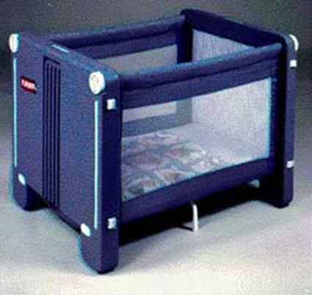
Introduction
You design a portable crib.
You have concerns about the crib’s safety.
Addressing these concerns would make the crib less likely to sell…
Notes:
(Make copies of the following scenario and questions to hand out to the class). You are a product designer for The Baby Spot, a manufacturer of children’s products. You recently designed a new portable crib, one which can be collapsed when not in use. The prototype was shown off at a trade show, and several top retailers expressed interest. A few potential buyers had slight difficulty “locking” the crib in the open position, but the reception was still generally good (the locking mechanism is essential to the crib’s safety, as it is the only thing that prevents the crib from collapsing on itself when occupied). Upon receiving the few complaints, you slightly redesign the crib so that it makes a clicking noise when locked properly. You are concerned that the redesign does not fully address the locking problem, but fear that a more thorough redesign would make the crib too heavy. You know that The Baby Spot’s CEO is expecting to make a big profit off of the crib, and wants the crib to be as light as possible. You also know that the crib is technically acceptable, because it meets all existing safety and testing standards. The reason for this is, as Trot Nixon, head of effort to sell the crib, states “there are no government or industry test standards applicable to the Playskool portable crib.”

Slide 3
Individual Questions to Consider
Should you redesign the crib, even if doing so would make it too heavy to sell?
2)Should your express your concerns? To whom?
Colleagues or your employer at The Baby Spot?
Retailers considering selling the product?
Anyone else?
3) If there are no applicable test standards, are your concerns frivolous?

Slide 4
4) When a company believes it has met its obligations (e.g. product testing), does it have a further duty to ensure the safety of its products?
5) What special considerations come into play for a product designed for infant or young childhood use?
6) If only 2 people out of 100 encountered a problem, what should be the response?
7) Should there be government test standards that apply to the crib? Lacking those, in a case like this with a newly designed product, what should engineers do to assure safety?
Industry Questions to Think About

Slide 5
Ethical Dilemmas
We encounter ethical dilemmas everyday.
People think engineering is all math and science, but engineers are often called about to make decisions that will have an impact on the end user’s health and safety.

Slide 6
Dangerous Products
No one has ever WANTED to develop an unsafe product.
Still, there have been over 4,000* recalled consumer products since the start of the Consumer Product Safety Commission in the early 70’s.
*research 4,000 (likely higher now)

Slide 7
Back to the Crib….
What should an engineer do regarding the crib?
What are the potential consequences of each action?
What would be the chain of reporting that you might follow if you have concerns about the safety?
What if you are met with indifference at the first level?
Is there anything that could prevent the crib from being fixed?

Slide 8
What to do…..
A lot of times, all the options are bad.
Let’s say you talk to management and…
They ignore you.

Slide 9
You can….
Option 1: Trust that management will make the right decision.
Pro: Management might decide to fix the crib.
Con: Management might decide not to fix the crib.
Option 2: Stand your ground!
Pro: The crib has a better chance of being fixed.
Con: Your boss now hates you.
Option 3: Don’t say anything!
Pro: Your boss doesn’t hate you.
Con: The crib is still dangerous, and this time you didn’t even give management a chance to fix it.
Which option would you choose?

Slide 10
Best Solution
A good solution would be to approach management in a non-confrontational way.
Of course, the BEST option is to develop a safe product in the first place, as is your duty as an engineer!
Notes:
a) Probably the best thing to do is approach the management in a non-confrontational way and explain to them your safety concerns, as well as ways to address these concerns.
c) Despite the difficulty of these options, your duty as an engineer makes it clear what you should so.
d) If you have reservations about a product that management is refusing to listen to, it is your duty to inform any relevant regulatory agencies of the problem.
A better solution is always to address all safety concerns throughout the design and development phase to avoid these either/or situations.

Slide 11
Code of Engineers
The code lists the following as its first rule: “Hold paramount the safety, health and welfare of the public.”
Only work in your area of competence!
Common Theme: Your duty is to the people!
No matter what conflicts of interest arise, your primary duty is always to develop safe products!
Notes:
The Engineer’s duty to public safety is articulated by the National Society of Professional Engineers Code of Ethics for Engineers
a) The full Code can be found at http://www.nspe.org/resources/pdfs/Ethics/CodeofEthics/Code-2007-July.pdf
The code lists the following as its first rule: “Hold paramount the safety, health and welfare of the public.”
a) It is important that this rule comes first, as it stresses the duty that engineers have to society.
b) That is why it is your duty to ensure nothing catastrophic happens, and that the welfare of the public is your paramount concern.
c) In fact, all of the other guidelines can be seen as coming from this idea of safety as a duty

Slide 12
Code of Engineers
Engineers shall issue public statements only in an objective and truthful manner.
Engineers shall act for each employer or client as faithful agents or trustees.
Engineers shall avoid deceptive acts.

Slide 13
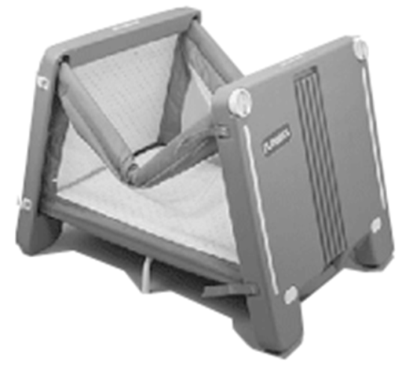
Back to Babies and Cribs….
The Dilemma was real!
That model of crib has killed at least 16 babies since 1990 including Danny Keysar whose parents founded KID, Danny was the crib’s 5th victim.
How many would have died if someone had spoken up? How many would have died if a safe crib had been designed in the first place?
Notes:
Going back to our initial scenario -- In fact, the “The Baby Spot” dilemma is real.
a) In real life, the crib was released in 1990, and several other manufacturers released similar models shortly after.
b) Around 1.5 million of these cribs have been sold.
c) Many share a common flaw in the locking mechanism, which makes them prone to collapsing while occupied.
d) These cribs have killed at least 16 babies to date, in most cases strangling them.
e) Not just the engineers, but many people in this process could have acted differently – both in the design and testing of the product and in informing the public once the product was recalled.

Slide 14
Discussion
1) Given the continual development of new products, how can manufacturer’s assure all safety concerns have been addressed before specific standards for the product are developed?
2) The CEO of The Baby Spot said, after hearing of several of the deaths and injuries, that he “couldn’t believe people could be so careless.” What assumptions are behind this statement? What obligations does an engineer have to ensure that its products are used in a manner they deem safe? What behavior can engineers reasonably expect from consumers?

Slide 15
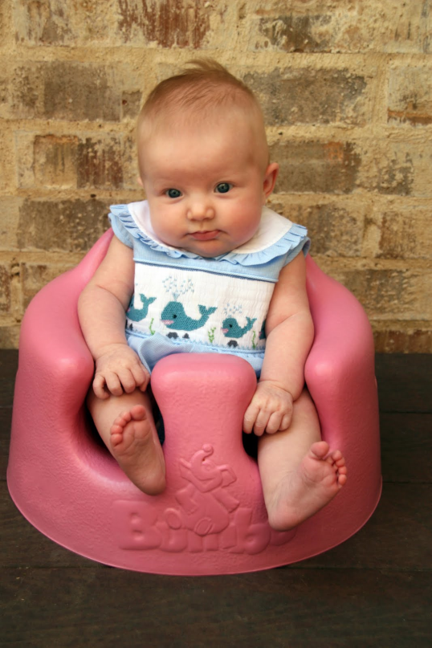
Baby Bumbo Seats
Baby Bumbo Seats are a wildly popular alternative to high chairs and swings which helps babies as young as 3 months sit upright and play
A recall warning was issued in 2007 and 2012 after the US Consumer Product Safety Commission (CPSC) had received around 100 complaints of injuries related to the baby seat, including more than 20 skull fractures
Bumbo International has sold 4 million seats in the US alone, all of which the CPSC are targeting in this safety action.

Slide 16
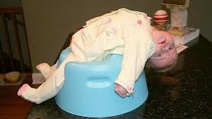
What should an engineer do regarding this product?
Is there a way to redesign the Bumbo Seat to be a safe place for babies?
Even Bumbo seats with seat modifications including straps have faced safety concerns
Is there anything that could prevent the Bumbo seat from being fixed?
What questions do you have for the makers of the Bumbo seat regarding safety concerns and ethical engineering?
Questions

Slide 17
Discussion
1) What would you have done as an engineer in that situation?
2) How should engineers have expressed their concerns if they discovered that the company was not listening?
3) Is it sufficient if the engineers simply expressed their concerns to the management?
4) What protocols could have been in place at the company to avoid manufacturing the faulty design in the first place?

Slide 18
1) Did Sam act appropriately in this situation?
2) Suppose Sam had been warned ahead of time that complaining about the respirators would get him fired. Should he still have complained?
Infants Under Pressure
Notes:
2) Infants Under Pressure (from http://www.onlineethics.org/cms/19482.aspx)
Sam Wilson, an experienced engineer was employed by MedTech, a company that made medical equipment. An important line of products were respirators, used in hospitals. A colleague of Sam asked him to check out one of these respirators, one designed for infant use. He soon determined that a relief valve intended to protect against overpressure being applied to the infant's lungs was incorrectly placed, so that, under certain circumstances, the infant could experience dangerously high pressure. Correcting the error would not be difficult, since all that was needed was to reposition the relief valve. In similar circumstances in the past, Sam had seen such problems handled with dispatch. He called the matter to the attention of the appropriate manager and assumed that it would be taken care of. A month or so later (Sam was not directly involved with this particular device) he learned that nothing had been done. Hundreds of these devices were already in use, and Sam was concerned about the increasing likelihood of a tragic event. He went back to the manager and urged him to take appropriate action. When the manager fended him off, Sam said that if prompt measures were not taken to correct the problem he would have to report it to the cognizant regulatory agency. The response of MedTech was to fire Sam.

Slide 19
A Final Problem
1) Was Bob right to resign?
2) Are there any other courses of action Bob should have taken?
3) Did Bob fulfill his duty as an engineer?
Notes:
Air Bags (from http://www.onlineethics.org/cms/19501.aspx)
SafeComp is a company that, among other things, designs and makes sensing devices for automobile air bags. Bob Baines was hired to work in the quality control department. About six weeks after starting work, he was asked to sign off on a design that he felt very uncertain about. He checked with people involved in the design and found the situation, at best, ambiguous. Bob told his manager that he would not feel right about signing off, and, since he was relatively inexperienced with SafeComp's procedures, asked that he not be required to do this. His manager kept applying pressure. Eventually, Bob decided that he wished neither to violate his principles by doing something that he thought was wrong, nor to become involved in a battle in which his career would certainly be major casualty. He quietly resigned.

Slide 20
Ethical engineering and safety consideration are significantly intertwined
People, including engineers encounter ethical dilemmas everyday
The Code of Engineers lists the following as its first rule: “Hold paramount the safety, health and welfare of the public.”
Even if there are risks to one’s job, it is the responsibility of an engineer to speak up about any unsafe products that could lead to harm or death for the consumer.
Conclusion

Slide 21
Contact
Kids In Danger
116 W. Illinois Street, Ste. 5E
Chicago, IL 60610
Phone: 312-595-0649
Fax: 312-595-0939
Email@KidsInDanger.org
www.KidsInDanger.org

