Slide 1
Safety Matters: Product Design, Safety, and Standards

Slide 2
Safety Matters: Overview
Problem of unsafe children’s products
Factors to consider while designing
children’s products
Design for Safety Resources
Goal: Integrate safety into product design
Notes:
Due to a tragic accident in 1998, when young boy died after a portable crib collapsed around his neck, KID has stepped in to improve children’s product safety. KID’s vision is a system that ensures the safety of all children through stringent standards, independent testing and a commitment from government and manufacturers that safety is their priority. Ultimately KID wants to ensure safe product development, and that can be done with the help of you, our future engineers.

Slide 3
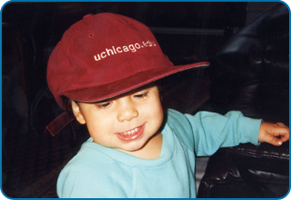
Kids In Danger (KID)
A nonprofit organization dedicated to protecting children by improving children’s product safety
Founded in 1998 by Linda Ginzel and Boaz Keysar following the death of their son, Danny Keysar who died as a result of a recalled portable crib
Our mission is to promote, advocate, and educate
Notes:
Background and Origins of KID: Kids In Danger (KID) is a nonprofit organization dedicated to protecting children by improving children’s product safety. KID was founded in 1998 by the parents of sixteen-month-old Danny Keysar who died when a portable crib collapsed around his neck in his Chicago childcare home. Although the portable crib had been recalled five years earlier, word of its danger had not reached Danny’s parents, caregiver, or a state inspector who visited the home just eight days before Danny’s death.
KID’s mission it to promote the development of safer products, advocate for children and educate the public, especially parents and caregivers, about dangerous children’s products.
KID’s goal is to create a secure environment for children by ensuring that safer products are manufactured, improving recall effectiveness, and encouraging parents and caregivers to remove dangerous or recalled products from homes and childcare facilities.

Slide 4
Children’s Product Facts
Unintentional injuries are the leading cause of death among children
During the 3 year period 2007-2009, the Consumer Product Safety Commission (CPSC) had reports of 341 deaths- an annual average of 114 deaths- associated with nursery products among children under age 5.
In 2011, there were an estimated 74,100 emergency room treated injuries associated with nursery products among children under the age of 5.
Children’s products are recalled on average of almost twice a week
Notes:
Source: https://www.cpsc.gov//PageFiles/136143/nursery11.pdf
Other sources: Regulations, Laws & Standards. U.S. Consumer Product Safety Commission (CPSC). 2013. Available at: http://www.cpsc.gov/en/Regulations-Laws--Standards/

Slide 5

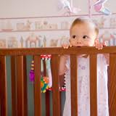
What are the most important aspects of designing for children?
Notes:
Ask the audience what they believe are the most important aspects of designing for children? The purpose of this slide is to begin a discussion about how engineers designing children’s product face different questions and considerations compared to those designing other products. Begin the discussion by asking students how they would approach designing a toy for a 4 month old, 2 year old, and a 4 year old. What key considerations must go into their design? How safety affect their initial design?

Slide 6
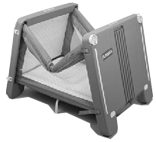
Case Study: Playskool Travel-Lite
What is the flaw in this design?
The Playskool Travel-Lite was recalled in 1993, Danny Keysar was the crib’s 5th victim in 1998
Notes:
A Lack of adequate testing and inability to fully contain the problem with a recall
The Playskool crib was originally designed by a draftsman with only a high school education. Kolcraft, the manufacturer, could not produce documents to show that any safety tests were actually performed and there was no evidence that any safety engineer tested the crib before it was sold.
Hasbro, under whose Playskool brand the product was sold, did not verify that any testing was conducted. They asked Kolcraft to provide test data but they never received any. And despite putting their Playskool name on the crib, Hasbro never tested the product.
The first child died within a year of the product going on the market; the sixth was killed a few months after Danny in 1998. In addition, 13 other children died in similar cribs which had incorporated the same flawed V-shaped design.

Slide 7
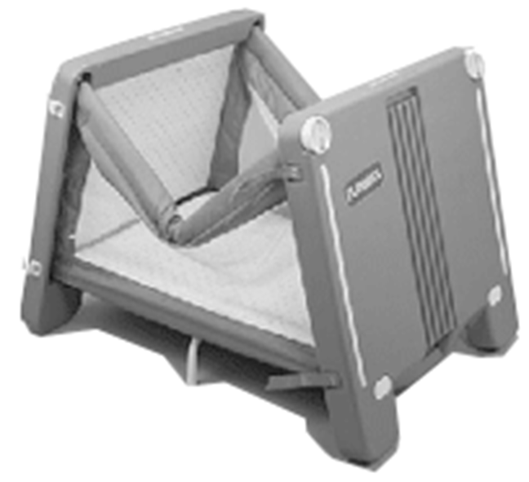


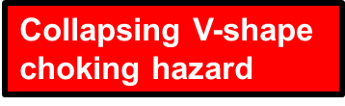
Case Study: Playskool Travel-Lite
The V-shape caused by a design flaw within the playpen created a strangulation hazard that killed Danny Keysar and at least 8 other children.

Slide 8
Kolcraft Sold the Patented
Design
Five companies built 1.5 million cribs with this flawed design.
Even after the recalls, 1.2 million cribs are unaccounted for.
At least 19 children have died from this design.

Slide 9
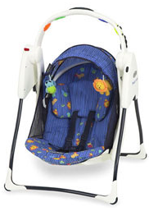
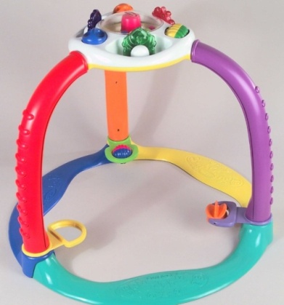
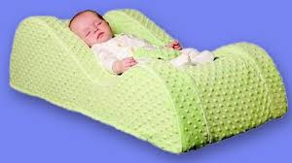
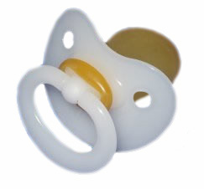
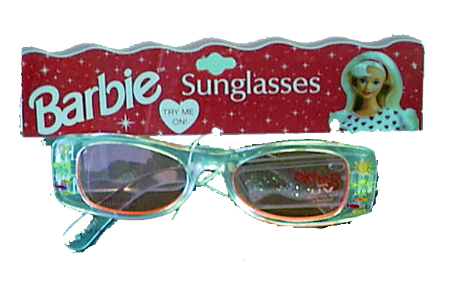
Other Children’s Products’ Design Flaws
Graco Travel-Lite Swing: Baby can fall forward
Wal-Mart Magic Start Crawl n’ Stand: Can tip onto child
Nap Nanny: infant can hang or fall over the side
Pacifier: May fall apart in child’s mouth
Sunglasses: Contained a harmful chemical on them
Notes:
Recall Sources
Graco Travel-Lite Swing: http://www.cpsc.gov/en/Recalls/2004/CPSC-Graco-Childrens-Products-Announce-Recall-of-Travel-Lite-Swings-/
CareBears Pacifier Recall: http://www.cpsc.gov/en/Recalls/2012/CareBears-Pacifier-Recalled-by-IDM-Group-Due-to-Choking-Hazard/
Walmart Magic Start Crawl n’ Stand: http://www.cpsc.gov/en/Recalls/2003/CPSC-Playskool-Announce-Recall-of-Magic-Start-Crawl-n-Stand-Toys-Sold-Only-at-Wal-Mart-/
Barie Sunglasses recall: http://www.cpsc.gov/en/Recalls/2001/CPSC-IMT-Accessories-Announce-Recall-of-BarbieTM-Sunglasses/

Slide 10

What is being done to improve product safety standards?
Notes:
With all of the aforementioned issues in product design, what is being done to control or watch the market for unsafe products?

Slide 11
The Consumer Product Safety Improvement Act (CPSIA)
Signed into law in 2008, CPSIA is already making children safer by enforcing:
  Mandatory Toy Standard (ASTM F963), which relates to safety requirements, labeling, and testing for: hazards caused by magnets; certain toxic substances; cords, straps, and elastics; battery‐operated toys; and more.
  Where testing is required, manufacturers and importers of children’s products must test their products using a third‐party accredited testing lab.
  The banning of several commonly used phthalates, a group of chemicals that are oily, colorless liquid that are used to make vinyl and other plastics soft and flexible (think rubber ducks).
  Stricter lead limits relating to lead in paint, total lead content, and children’s metal jewelry
Notes:
Other changes and new standards can be found at http://www.cpsc.gov//PageFiles/113995/cpsiasbguide.pdf this guide would be useful to hand out to students when designing products as they are the manufactures in this situation and must adhere to the standards and laws protecting the safety of children using these products

Slide 12
Causes of Children’s Product Failures? Lack of Testing and Limitations
  Even with the passing of the CPSIA, some products still don’t have standards or are required to be tested including
    Products made of natural materials such as amber, feathers, fur, leather, etc.
    Dyed or un-dyed textiles (cotton, wool, hemp, nylon, etc.), including children's fabric products, such as baby blankets, and non-metallic thread and trim.
  CPSC is a small organization with limited staff and resources often the magnitude of products to investigate can be overwhelming and many unsafe products are left on the shelf pending the investigation
  CPSC can issue a recall on a defective item, but that only addresses a problem AFTER a child or children have been injured or killed by the product .
Notes:
Source: http://www.cpsc.gov//PageFiles/113995/cpsiasbguide.pdf
All of these problems are key considerations as to why children are still being injured despite increased safety standards, are there other methods to make children’s products safer? What ideas do the students have to decrease these problems? What else can be done?

Slide 13
What more can be done?
One solution lies in YOU!
As engineers, we can work to consider all aspects of safety and implement those in our design, followed by product safety testing.
Next we will discuss design stage considerations.

Slide 14
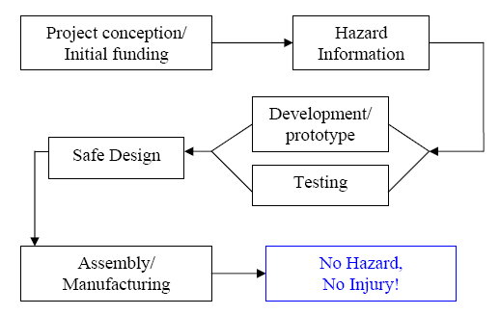
Design Process
Notes:
http://www.elcosh.org/document/1866/d000825/Construction%2BDesign%2BSafety%2Bin%2Bthe%2BMarketplace.html?show_text=1
Here we see a general overview of the design process. Keep these stages in mind while we continue our discussion.

Slide 15
Questions at the Design Stage
Is the product safe?
  What potential hazards are associated with this kind of product? (i.e. bath seats, drowning)
  How does this product address the hazard?
  How could it fail and could a failure mode cause injury?
How will it be used?
  How will children/caregivers interact with it?
  What is the size/shape/strength of user and in what environment?
Can it be designed better?
Engineers must ask these questions – so parents won’t have to.
Notes:
Pose these questions to class as considerations that must be kept in mind at every step of the design process.

Slide 16
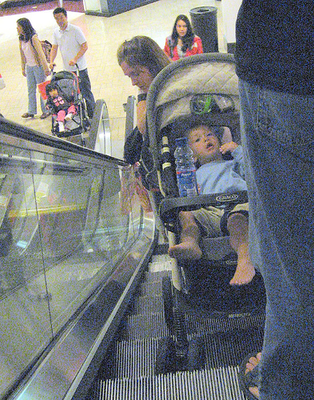
How will the product be used?
Manufacturer’s suggested use vs. foreseeable use
Play pens carry a warning “do not leave unattended” when it is widely used as a sleeping crib and even marketed for that.
Convenience vs. Safety
Sometimes the parent’s convenience appears to be more important that the baby’s safety: examples include bath seats, baby carriers, and all in one products
An engineer must be mindful of this in any product design
Notes:
A key factor an engineer must consider is that the intended use of a children’s product in reality in not the only use. For example when designing a stroller, the engineering must recognize that despite numerous warning telling children not to climb on the product, they still will. The stroller design must be durable and safety for a child weighing anywhere from 20 to 40 pounds to be able to crawl into the seat without injury. Parents do not constantly monitor children and the products the child is using must be able to respond to the unintended uses as well as the suggested uses. For Discussion: How does an engineer go about design for this? What additional safety measures can be included in a stroller to reduced the danger of intended usage injuries? Are warning labels sufficient? What else can be done?

Slide 17
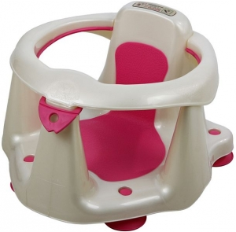
Other Market Factors to Consider
The market for infant goods is constantly changing.
  For example: most crib purchasers buy a crib only once -- maybe twice. So almost everyone is ‘new’ to the market
Income and Interest
  Today’s parents have disposable income, used to new gadgets, status products, but not really tuned in to safety
Development of Users
  Children grow, can the product withstand the increased size and weight of a child?
Recalled 12/2012 Dream On Me Bath Seats: Seats can fall over creating a drowning hazard
Notes:
Recall: http://www.cpsc.gov/en/Recalls/2013/Dream-On-Me-Recalls-Bath-Seats-Due-to-Drowning-Hazard/
“The bath seats fail to meet federal safety standards, including the requirements for stability. Specifically, the bath seats can tip over, posing a risk of drowning to babies. CPSC and Dream On Me have received five reports involving these bath seats, including a report of a near drowning involving a 12-month-old baby girl. The baby did not require medical treatment. “

Slide 18
Part 2: Designing a Safe Product
Standards
Human Factors
Testing
Resolving design flaws
Design for Safety related to other areas of design

Slide 19
Standards
Assure both conformity and safety
Can be voluntary or mandatory
Involve both performance requirements and test methods
Represent minimum requirements only
Standards and testing procedures must keep up with new types of products.
Notes:
*Strict mandatory standards would involve relevant test methods to accurately and thoroughly test products for flaws, standards that address how a product is actually used, and uses existing data to determine past and current risks in different types of products.

Slide 20





Standards Agencies
US Consumer Product Safety Commission (CPSC)
National Highway Traffic Safety Administration (NHTSA)
Underwriters Laboratories Inc
ASTM
ANSI
ISO
Global market
Other countries have standard setting agencies

Slide 21
Human Factors
Both standards and hazard analysis should account for human factors.
How will the product be used?
  Intended use
  Likely use
  Foreseeable use
  Misuse

Slide 22
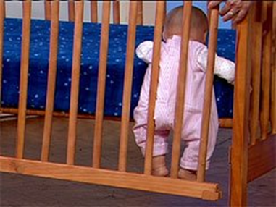
Example: Designing a Safe Crib
Key Considerations for design safety:
Slats are spaced no more than 2-3/8 inches
Mattress fits snugly — no more than two fingers width between edge of mattress and crib side.
    Mattress support is securely attached to the headboard and footboard.
Corner posts are no higher than 1/16 of an inch (1-1/2 mm) above the top of the end panel.
Drop-side latches cannot be easily released by a baby and securely hold side in raised position.
All screws, bolts and other hardware are present and tight.
In the last 20 years 1,100 children have died from crib related injuries. Over 14,500 children are rushed to emergency rooms with injuries and an average of 41 children die each year in unsafe cribs.
Notes:
http://www.cpsc.gov/PageFiles/129289/202.pdf
With out these requirements, safety issues arise when the crib is in use. A crib with slats spaced too far apart pose a danger to the child’s limbs becoming trapped or injured. A mattress that is too small poses a suffocation risk to the child should they become wedged between the mattress and crib wall. Corner posts can be catchpoints for items around the child’s neck or their clothing. As we see in this picture, drop-side latches must function properly in order that the child does not become entrapped. And finally, bolts and hardware must be securely installed to provide the greatest stability of the product.
http://www.cpsc.gov/en/safety-education/safety-guides/kids-and-babies/the-safe-nursery/

Slide 23

Performance and Test Methods
Result we look for in testing, e.g.: Stroller shouldn’t collapse unexpectedly
  Performance: when tested, latches should not break or release
Specify how product should be tested?
Notes:
*Standards attempt to set performance measurements – not design specifications when possible to allow the most freedom in designs.
*Testing, however, must be very specific and address specific problems. If you are developing a new stroller that uses a latch to keep the baby in place, the product designers should immediately ask what problems could potentially arise.
*For example, a potential problem could be the strap breaking or releasing unexpectedly. Tests would then be developed to see if latch malfunction is possible on the stroller, and if so, ways to correct this problem.
*This type of mandatory testing would weed out many problems in infant products (and consumer products in general) before they were released.

Slide 24
Testing your Product
In-house testing
Independent Testing
    Underwriters Laboratories
    Intertek
    Bureau Veritas
    ITS
    CSA
  More listed at the CPSC website

Slide 25
Design Safety
If you find a flaw…
  1. Can you design the flaw out?
    Always the first choice
  2. Can you guard against the flaw?
    Physical aspects of the product
  3. Labeling and Warnings
    This should only be the solution when the other two are not present

Slide 26

Recalls
Most recalls are voluntary.
  Can a voluntary recall be effective?
  Sometimes more than 80% of a given product can remain in circulation years after a recall
Notes:
The CPSC works with companies to issue voluntary recalls when possible. The benefits of a voluntary recall are that they avoid expensive and protracted legal battles.
The downside to voluntary recalls, however, is that the company whose product is being recalled has to approve every step of the process. This means that everything from a press release to an informational poster can be watered down in tone by a company that wishes to save face.
In many cases, recalls fail to reach over 80% of a given product’s consumers. For example, this was the case with Danny: The crib that killed Danny had been recalled 5 years earlier, unbeknownst to Danny’s parents, the childcare center, or the state inspector who had been to the childcare center only 8 days earlier. As we can see, the repercussions and implications can be very serious, and bring to like the question of the effectiveness, and ethics, of voluntary recalls.

Slide 27
Design for Safety means…
Design for Efficient Manufacturing
Design for Assembly
Design for Robustness
Design for Environment
Design for Human Use
All while considering: Design for Profit $$$

Slide 28
Resources
Anthropometric Data
Developmental information from pediatricians
Injury data from similar products
Research by testing labs or others into use patterns
Notes:
There are many resources available on how to create good and thorough standards for children’s products including: ^^

Slide 29
Product Safety Resources
Regulations, Laws & Standards
www.cpsc.gov
www. saferproducts.gov
Code of Ethics for Engineers
http://www.nspe.org/resources/pdfs/Ethics/CodeofEthics/Code-2007-July.pdf
Basic Elements of Product Safety Engineering
http://www.hazardcontrol.com/factsheets/pdfs/basic-elements-of-product-safety-engineering.pdf
Design Hazard Analysis
http://www.intertek.com/risk-management/design-hazard-analysis/
ASTM International- Students page
http://www.astm.org/studentmember/index.html
Notes:
Many people assume that if something is sold at a “reputable” store, the U.S. government has made sure it is safe. However, this could not be farther from the truth. The reality is that most consumer products face a patchwork of mandatory and voluntary standards that allow dangerous products to be released on the market.
As politicians and pundits argue constantly over whether government regulation is evil or not, children like Danny Keysar are dying every year in ways that could, and should, be prevented.
As future engineers, it is our hope to help foster a strong orientation to product safety and testing in the future work you will do.

Slide 30

Kids In Danger
116 W. Illinois Street,
Suite 4E
Chicago, IL 60654
Phone: 312-595-0649
Fax: 312-595-0939
Email@KidsInDanger.org
www.KidsInDanger.org

