Slide 1

Conflicts of Interest
Professional Integrity: Best Practices For Publishing Your Research
You will be able to…
  Identify different types of interests and potential conflicts of interest (COIs)in publishing
  Design effective ways to manage potential COI situations in the role of author, reviewer, and editor
  Describe and apply good practices for dealing with COIs in publishing

Slide 2

APS Professional Skills Training
Presenter Disclosure Information
Presenter: Jane Smith, PhD, Professor of Genome Biology, University of Middletown
Disclosure Information: I have no conflicts of interest to disclose for this presentation.
As reported on 1/17/16

Slide 3
APS Professional Skills Training
Presenter Disclosure Information
Presenter: Joan Smith, PhD, Professor of Genome Biology, University of Big City
Disclosure Information: I serve on the Board of Directors for Genome Sciences LLC. I receive royalties from NOP Publishing for my book “Conflicts Are Interesting in Genome Sciences.” My husband, C. Brooks, is a paid consultant for Genome Technology LLC.
As reported on 1/17/16

Slide 4

What Are Your Interests?
Obtain Funding
Produce Results
Be Right
Support Hypothesis
Seek Recognition
Gain Resources
Enjoy Life
Maintain Relationships
Be First
Publish Findings
Seek Promotion

Slide 5
What is a Conflict of Interest?
According the to ICMJE guidelines…
“A conflict of interest exists when professional judgment concerning a primary interest (such as patients' welfare or the validity of research) may be influenced by a secondary interest (such as financial gain). Perceptions of conflict of interest are as important as actual conflicts of interest.”
International Committee of Medical Journal Editors
http://www.icmje.org/recommendations/browse/roles-and-responsibilities/author-responsibilities--conflicts-of-interest.html

Slide 6
What is a Conflict of Interest?
According the to ICMJE guidelines…
“A conflict of interest exists when professional judgment concerning a primary interest (such as patients' welfare or the validity of research) may be influenced by a secondary interest (such as financial gain). Perceptions of conflict of interest are as important as actual conflicts of interest.”
International Committee of Medical Journal Editors
http://www.icmje.org/recommendations/browse/roles-and-responsibilities/author-responsibilities--conflicts-of-interest.html

Slide 7

Possible Conflicts of Interest Include:
FINANCIAL RELATIONSHIPS
Employment, consultancies, honoraria, expert on trials
PERSONAL RELATIONSHIPS
Spouses, collaborators, and mentors
AUTHOR–SPONSOR AGREEMENTS
RIVALRIES
ACADEMIC COMPETITION
INTELLECTUAL BELIEFS

Slide 8

If your financial or personal relationships or actions were public knowledge, would they diminish the public’s trust in your research and credibility of your published articles?
International Committee of Medical Journal Editors
http://www.icmje.org/recommendations/browse/roles-and-responsibilities/author-responsibilities--conflicts-of-interest.html

Slide 9
What Are Your Interests?
Pair with the person next to you and describe any interests that could influence your current project.
  Which ones could be considered conflicts of interest?
  Be ready to share your responses with the rest of the class.
DISCUSS

Slide 10
Conflicts of Interest as an Author

Slide 11

Journals Require Authors to Disclose
Potential Conflicts of Interest
  Did you or your institution receive payments or services from a third party for any part of the submitted work?
  Have you had a financial relationship with sponsors within the past 3 years?
  Do you have other relationships that could appear to influence your work?

Slide 12
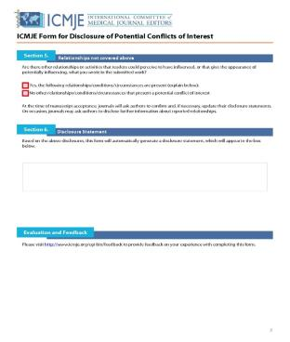
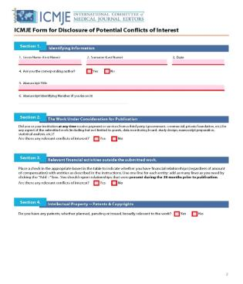
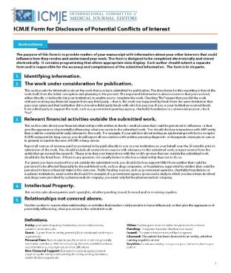
The Complete ICMJE Form for Disclosure of Potential Conflicts of Interest Is Located in Your Homework
International Committee of Medical Journal Editors http://www.icmje.org/conflicts-of-interest/

Slide 13
Conflicts of Interest Statements Are Reported in the Published Manuscript: Examples
Disclosures
No conflicts of interest, financial or otherwise, are declared by the author(s).
Competing interests
The author has completed the ICMJE unified disclosure form and declares no support from any organization for the submitted work; no financial relationships with any organization that might have an interest in the submitted work in the previous three years; and no other relationships or activities that could appear to have influenced the submitted work.
Disclosures
A patent has been filed for the REM-monitoring system to authors DG and MK.

Slide 14
COI disclosures make readers aware of the potential that an author of the publication may have a bias.
It does not mean that the results are biased or unreliable.

Slide 15

Merely disclosing COIs does not satisfy all of an author’s ethical responsibilities.
Each author is still responsible for reporting results and interpretations truthfully.

Slide 16

Failure to Disclose Actual or Perceived COIs
Is a Problem During Review
Dear Editor,
This paper describes the health benefits of a new drug made by Startup Company Y. I went to the company’s website to learn more about the new drug and the first author’s picture are everywhere. The first author is described as being the lead expert for the company.
I am quite surprised. Did the author disclose this relationship?
Sincerely,
Cautious Reviewer

Slide 17
Failure to Disclose Actual or Perceived COIs
Is a Problem After Publication
Dear Editor,
My institution asked me to tell you that I forgot to disclose my relationship with the company that partially funded this research.
Do I need to do anything to correct this omission in two of my published articles?
Sincerely,
Last author
1
2
Dear Author,
Can you describe the relationships that you failed to disclose during review?
Sincerely,
Editor
Dear Editor,
Five of the co-authors, including myself, have share-holder interest in the company. Also, two of us invented some of the products made by the company.
Sincerely,
Last author
Dear Author,
Thank you. Please draft a corrigendum that declares these relationships. We will confirm the text with your academic institution.
Sincerely,
Editor
3
4

Slide 18
Conflicts of Interest as a Reviewer
Can you describe an instance when a reviewer
might have a conflict of interest?

Slide 19


You Should Not Review a Manuscript if:
  The authors are close friends of yours
  There is a professional conflict
  You have ideological biases toward the research
  You recently collaborated with the researchers (within 3 yrs.)
  The authors are from the same institution as you
  You have a relationship with a company that sponsored the studies

Slide 20

You Can Accept an Invitation to
Review a Manuscript if You:
  Study the same topic
  Are competitors
  Once collaborated with the researchers (over 3 years ago)
  Disclose any perceived conflicts of interest to the editor
  Can provide an honest and fair assessment of the research
  Can maintain confidentiality throughout the process
  Can return the review in a timely manner

Slide 21

Participating in Manuscript Reviews with Your Advisor Is Okay
  Be sure that the journal is informed that the review was performed in collaboration with a junior colleague
  Remind all reviewers to maintain confidentiality

Slide 22

An Opportunity to Review
You are a graduate student in biological engineering. Your advisor hands you a manuscript that she has been asked to review for the Journal of Physiology.
  The manuscript is closely related to your dissertation work, but does not actually address the questions you plan to investigate.
  Your advisor asks you to write a review of the paper and return it to her by the end of the week.
    Is this appropriate?
    What questions should you ask?
Contribution of case study by John Halliwill, PhD, Professor of Human Physiology, University of Oregon

Slide 23
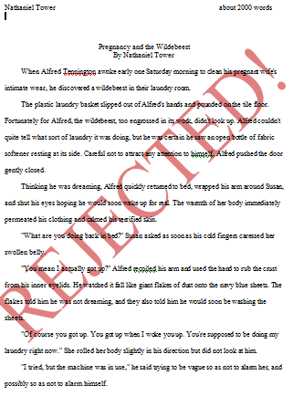
An Opportunity to Advance Your Research
  Despite your great insights, the paper you helped review has been rejected by the Journal of Physiology.
  As you further develop plans for your dissertation work, you remember the article, and it gives you an idea for a new study that could build on their work and your work in a very positive way.
  Do you revise your dissertation plan to include the new idea?
Contribution of case study by John Halliwill, PhD, Professor of Human Physiology, University of Oregon

Slide 24
Conflicts of Interest as an Editor
Can you describe an instance when a Journal Editor might have a conflict of interest?

Slide 25
Editors Ensure that the Review Process Is Fair
All manuscripts should:
  Be considered for publication with the same criteria for evaluation
  Be reviewed by subject matter experts
  Receive a timely and constructive review
  Remain confidential throughout the process

Slide 26

Editors Should Decline Facilitating
Review of a Manuscript if…
  The manuscript is from their own lab, institution, or close friend
  There are ideological biases toward the research
  There is pressure to accept or reject the manuscript without appropriate consideration

Slide 27
The Editor’s Prerogative
TWO WEEKS LATER…
Dear Editor,
I hope you like this article. I recommend several reviewers: A. Smith, B. Jones, and C. Lee. Please do not send it to: D. Liang, E. Butler, or anyone who studies plant parasites.
Sincerely,
Plant parasite expert and author
Review from D. Liang:
This is a very interesting paper. However, there is room for clarification. Please have the author address the following concerns…
Review from A. Smith:
This author is a good guy.
However, I found the manuscript to be confusing. The study does not seem to be that interesting because…
Review from Plant Parasite Scientist:
What a novel contribution to the field. This work would be great if authors clarified...

Slide 28

The Special Issue
The Journal of Applied Math is preparing a special issue on the topic “Wifi Wavelength and Health.” The editor in chief is an expert on the topic and plans to contribute four articles to the issue.
  Should the editor’s articles undergo peer review?
  Should the editor in chief facilitate the peer review process for her articles?
  Are there other steps she should take to avoid the perception of a conflict of interest?

Slide 29
SMALL GROUP ACTIVITIES
Your instructor will provide directions for these activities
These activities will help you APPLY what you have learned so far to common scenarios
BE SURE to add notes from this presentation to your “My Publications Best Practices” document.
DISCUSS

Slide 30
Conflicts of Interest
End of Presentation. Open Discussion.
  Access more APS Professional Skills Training Courses at www.the-aps.org/pst
  This module is part of a series of seven teaching modules designed to promote best practices in publication ethics for life scientists and biomedical engineers who publish research papers. The modules were developed with support from the National Science Foundation (NSF) (#SES -1238368) and in collaboration with staff and members of the APS, BMES, and SBE. The modules represent the views of the authors and do not necessarily represent the views of NSF, APS, BMES, or SBE. The information in these modules is designed to represent a summary of good practices and advice at the time of publication. They are not meant to serve as legal advice or publisher policy and do not in any way guarantee protection from professional ethics charges.
  For more information on how the materials were developed and tested, please contact the authors.

