Slide 1

Data Management And Integrity
Professional Integrity: Best Practices For Publishing Your Research
You will be able to…
  Describe and apply professional standards of practice for managing, archiving, and sharing data
  Describe and apply professional standards of practice for presenting findings in manuscripts, presentations, and proposals
  Develop criteria for assessing quality of data prepared by colleagues and findings reported in the literature
  Formulate good practices for presenting digital and non-digital data to enhance clarity and avoid inappropriate manipulation via figures and legends

Slide 2

“May I have the data?”
Let’s listen to an exchange between two scientists about a request for more information regarding a published article
  Have you ever tried to repeat an experiment that was reported in the literature?
  Have you ever been unable to get the same results as reported in the literature?
WATCH

Slide 3

Play video
“Data Sharing and Management Snafu in 3 Short Acts” by Karen Hanson, Alisa Surkis, and Karen Yacobucci, NYU Health Sciences Libraries, August 3, 2012.
https://www.youtube.com/watch?v=N2zK3sAtr-4

Slide 4

What are Good Practices for Keeping a Record of Your Data?
  Label your data clearly (date / experiment / lanes / treatments)
  Save versions of data at each step of modification (from raw data to figures prepared for publication)
  Specify the pieces of data that are included in your manuscript
Could your advisor readily locate a piece of your data if you had to instruct him/her over the phone or by email?

Slide 5
Recordkeeping Regulations
You are required to save your data
NSF funded: “Financial records, supporting documents, statistical records and other records pertinent to a grant will be retained by the grantee for a period of three years from submission of the Final Project Report described in GPM 342, “Final Project Report,” (with exceptions)
http://www.nsf.gov/pubs/manuals/gpm05_131/gpm05_131.pdf
NIH funded: “Grantees generally must retain financial and programmatic records, supporting documents, statistical records, and all other records that are required by the terms of a grant, or may reasonably be considered pertinent to a grant, for a period of three years from the date the annual FFR is submitted.”
http://www.fic.nih.gov/Grants/Pages/records.aspx

Slide 6
Recordkeeping Regulations
You are required to save your data
NSF funded: “Financial records, supporting documents, statistical records and other records pertinent to a grant will be retained by the grantee for a period of three years from submission of the Final Project Report described in GPM 342, “Final Project Report,” (with exceptions)
http://www.nsf.gov/pubs/manuals/gpm05_131/gpm05_131.pdf
NIH funded: “Grantees generally must retain financial and programmatic records, supporting documents, statistical records, and all other records that are required by the terms of a grant, or may reasonably be considered pertinent to a grant, for a period of three years from the date the annual FFR is submitted.”
http://www.fic.nih.gov/Grants/Pages/records.aspx
Data are owned by the institution.
Original files should remain at the institution.

Slide 7
Critique Your Lab Notebook
With the person next to you, swap lab notebooks and assess
whether experimental details are clearly labeled including:
  Hypothesis/ experiment rationale
  Date experiment was performed
  Reagents used and details about reagents
  Protocol performed
  Notes about changes to protocol, errors, questions
  Data or location where data are stored
  Location noted of stored samples from experiment
DISCUSS

Slide 8

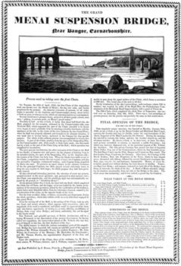
There Is an Art and Science in
Turning Raw Data into Polished Figures
Figure 1
Figure 2
Figure 3

Slide 9

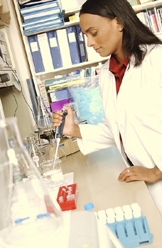


Data Presentation Integrity
Readers trust that experiments were performed as
described, and interpreted in an unbiased manner

Slide 10
Avoid Deception
According to the American Chemical Society’s
guidelines on the ethical practice of research:
“An author’s central obligation is to present an accurate and complete account of the research performed, absolutely avoiding deception, including the data collected or used, as well as an objective discussion of the significance of the research. Data are defined as information collected or used in generating research conclusions. The research report and the data collected should contain sufficient detail and reference to public sources of information to permit a trained professional to reproduce the experimental observations.”
Ethical Guidelines to Publication of Chemical Research, American Chemical Society
http://pubs.acs.org/userimages/ContentEditor/1218054468605/ethics.pdf

Slide 11

What Steps Do You Take to Prepare Good Data in Your Lab?
  Review the literature
  Make a hypothesis
  Establish a protocol
  Determine sample size
  Define method to analyze results
  including statistics
  Repeat experiments
  Analyze results
  Troubleshoot problems
  Discuss findings with colleagues
  Validate reagents
  Log process, changes, results, and analyses

Slide 12


How Do YOU Assess Whether Results Reported in Articles Are Likely to Be Reliable?
  Review the results
  Read the legends
  Read the methods
  Consider whether interpretation of findings correlates with data presented
  Contact the author

Slide 13


What Else Should Be Considered When Assessing the Quality and Validity of Data Presented in a Scholarly Article?
  Were experiments performed blinded?
  Were basic experiments repeated?
  Were all results presented?
  Were there positive and negative controls?
  Were reagents validated?
  Were statistical tests appropriate?
C.G. Begley, Six red flags for suspect work, Nature, 23 May 2013, Vol 497: pg 433

Slide 14
“The results show what?”
Share examples of poorly presented figures with the class.
  Explain why the presentation is not ideal.
  What could be corrected?
DISCUSS

Slide 15
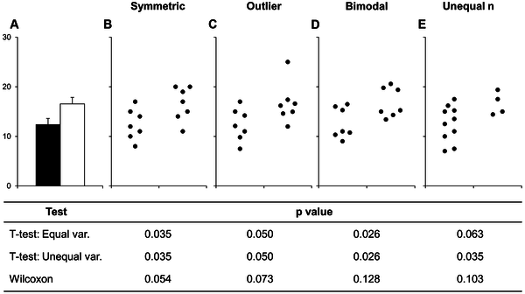
Fig 1. Many different datasets can lead to the same bar graph.
Weissgerber TL, Milic NM, Winham SJ, Garovic VD (2015) Beyond Bar and Line Graphs: Time for a New Data Presentation Paradigm. PLoS Biol 13(4): e1002128. doi:10.1371/journal.pbio.1002128
http://journals.plos.org/plosbiology/article?id=10.1371/journal.pbio.1002128

Slide 16
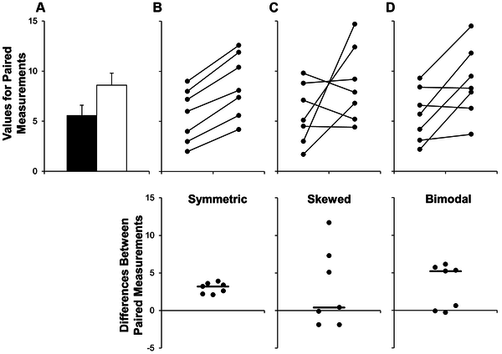
Fig 2. Additional problems with using bar graphs to show paired data.
Weissgerber TL, Milic NM, Winham SJ, Garovic VD (2015) Beyond Bar and Line Graphs: Time for a New Data Presentation Paradigm. PLoS Biol 13(4): e1002128. doi:10.1371/journal.pbio.1002128
http://journals.plos.org/plosbiology/article?id=10.1371/journal.pbio.1002128

Slide 17
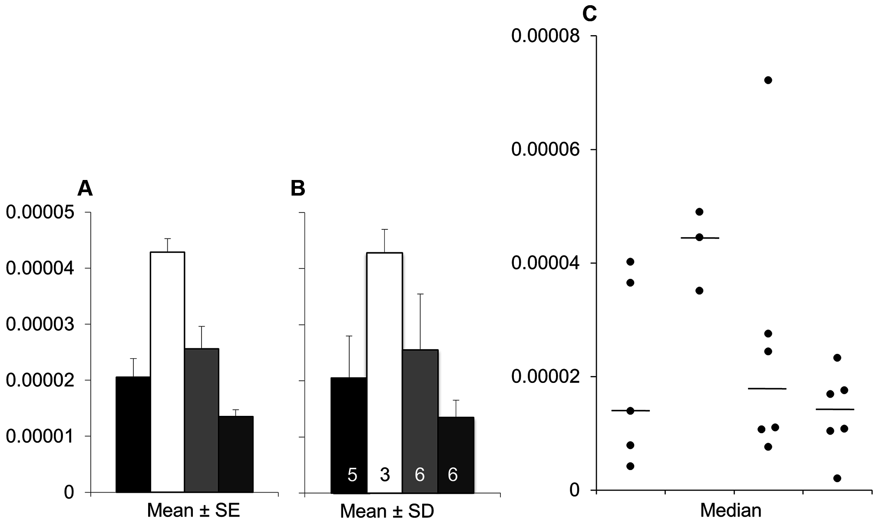
Fig 3. Bar graphs and scatterplots convey very different information.
Weissgerber TL, Milic NM, Winham SJ, Garovic VD (2015) Beyond Bar and Line Graphs: Time for a New Data Presentation Paradigm. PLoS Biol 13(4): e1002128. doi:10.1371/journal.pbio.1002128
http://journals.plos.org/plosbiology/article?id=10.1371/journal.pbio.1002128

Slide 18
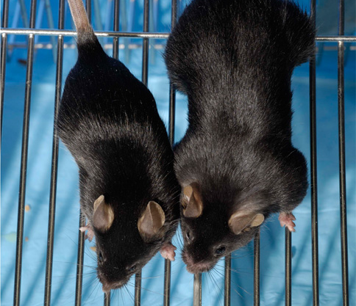
Compare 3 Experiments
  These experiments all use hindlimb suspension for various periods of time to assess changes in body weight and muscles mass of the animals.
  Two experiments analyze Myostatin knockout mice (Mstn-/-). Myostatin is a protein that regulates muscle growth. Without myostatin, muscles grow much larger than normal.
Lee S-J (2007) Quadrupling Muscle Mass in Mice by Targeting TGF-ß Signaling Pathways. PLoS ONE 2(8): e789. doi:10.1371/journal.pone.0000789. Used with permission per Creative Commons Attribution 2.5 Generic license.

Slide 19
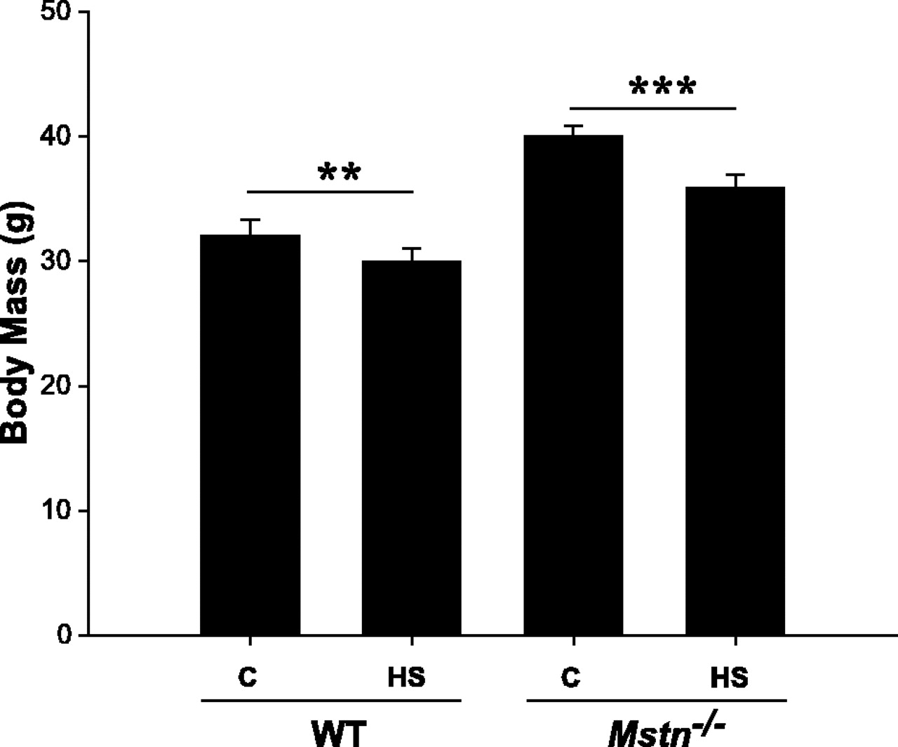
Myostatin-deficient Mice Lose More Skeletal Muscle Mass than Wild-type Controls During Hindlimb Suspension
Figure legend: Mean ± SE body mass of wild-type (WT) and myostatin gene-deficient [Mstn(-/-)] mice subjected to 7 days of hindlimb suspension (HS) or serving as ground-based controls (C). **P < 0.01 and ***P < 0.001, differences between treatment groups (within genotype).
McMahon C D et al. Am J Physiol Endocrinol Metab 2003;285:E82-E87

Slide 20
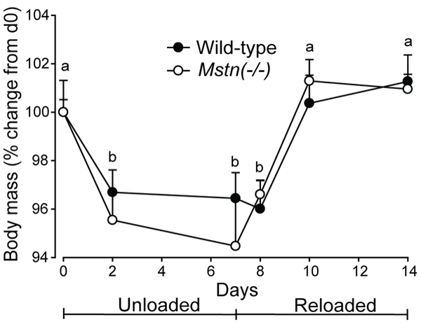
Translational Signalling, Atrogenic and Myogenic Gene Expression during Unloading and Reloading of Skeletal Muscle in Myostatin-Deficient Mice
  Figure 1. Body mass (mean+sem) for Mstn(−/−) and wild-type mice during seven days of unloading followed by seven days of reloading (n = 6 per genotype and day). Unlike letters denote significant differences (P<0.05) across days (independent of genotype).
Smith HK, Matthews KG, Oldham JM, Jeanplong F, Falconer SJ, et al. (2014) PLoS ONE 9(4): e94356. doi:10.1371/journal.pone.0094356 http://journals.plos.org/plosone/article?id=10.1371/journal.pone.0094356

Slide 21
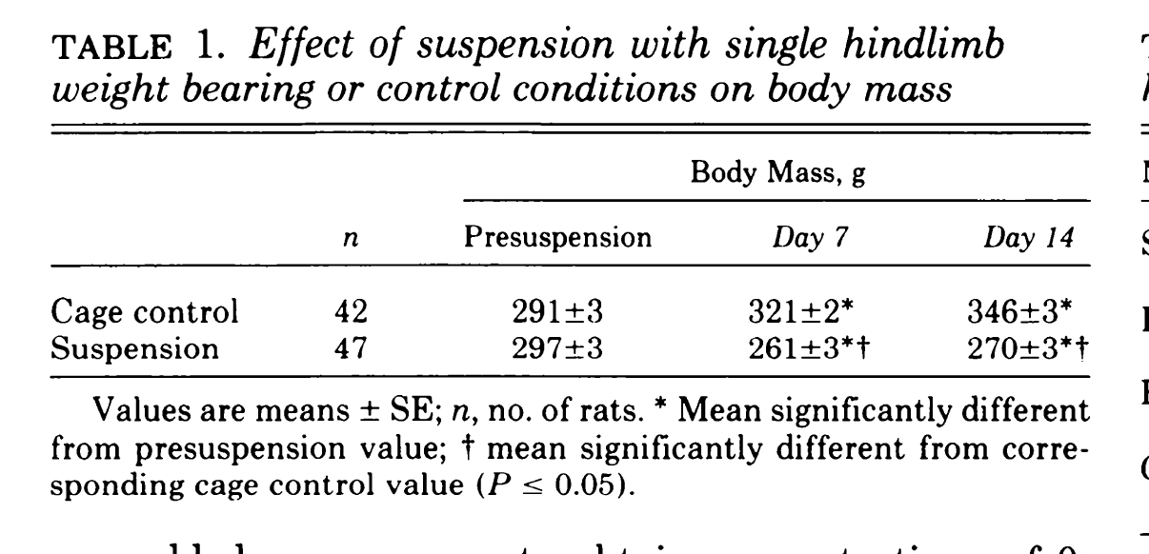
Muscle glucose update in the rat after suspension with single hindlimb weight bearing
Stump CS et al., Journal of Applied Physiology 1993 May; 74(5):2072-8

Slide 22
Digital Data Presentation Guidelines
Does your favorite journal provide data presentation guidelines? Share one of the guidelines with the class.
DISCUSS
Selective Presentation
Selective Enhancement
Order and Rearrangement

Slide 23
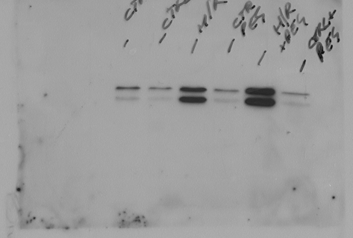
The Original Capture
Always save the original capture!
  This is an image of a Western blot obtained when the protein analysis experiment was performed.
  The image has not been adjusted or edited with photo-editing software (e.g., PowerPoint, Photoshop).
  This type of image is defined as an “original capture.”

Slide 24
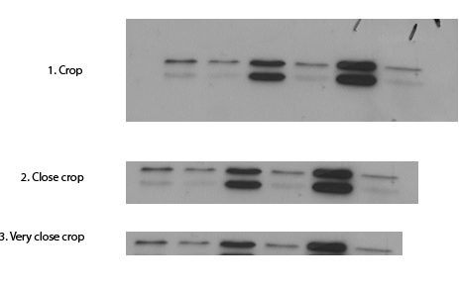
Selective Presentation: Cropping
1. Crop
2. Close Crop
3. Very Close Crop

Slide 25
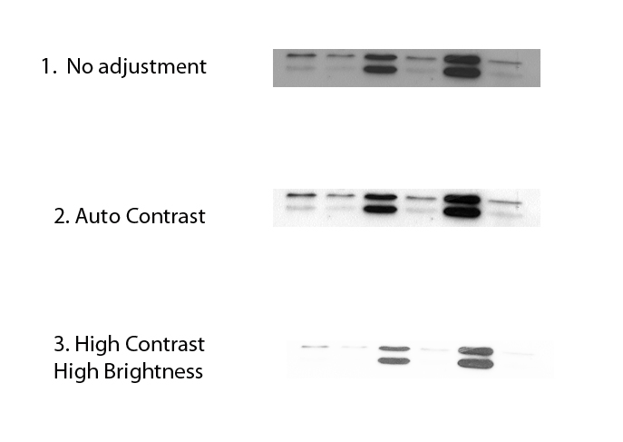
Selective Enhancement: Brightness/Contrast Adjustment
1. No Adjustment
2. Auto Contrast
3. High Contrast
High Brightness

Slide 26
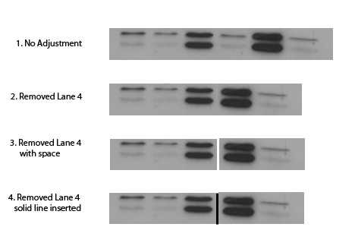
Order and Rearrangement
1. No Adjustment
2. Removed Lane 4
3. Removed Lane 4
with Space
4. Removed Lane 4
Solid Line Inserted

Slide 27
Small Group Activities
Your instructor will provide directions for these activities
  These activities will help you APPLY what you have learned so far to common scenarios.
  BE SURE to add notes from this presentation to your “My Publications Best Practices” document.
DISCUSS

Slide 28
Data Management And Integrity
  Access more APS Professional Skills Training Courses at www.the-aps.org/pst
  This module is part of a series of seven teaching modules designed to promote best practices in publication ethics for life scientists and biomedical engineers who publish research papers. The modules were developed with support from the National Science Foundation (NSF) (#SES -1238368) and in collaboration with staff and members of the APS, BMES, and SBE. The modules represent the views of the authors and do not necessarily represent the views of NSF, APS, BMES, or SBE. The information in these modules is designed to represent a summary of good practices and advice at the time of publication. They are not meant to serve as legal advice or publisher policy and do not in any way guarantee protection from professional ethics charges.
  For more information on how the materials were developed and tested, please contact the authors.

