Slide 1
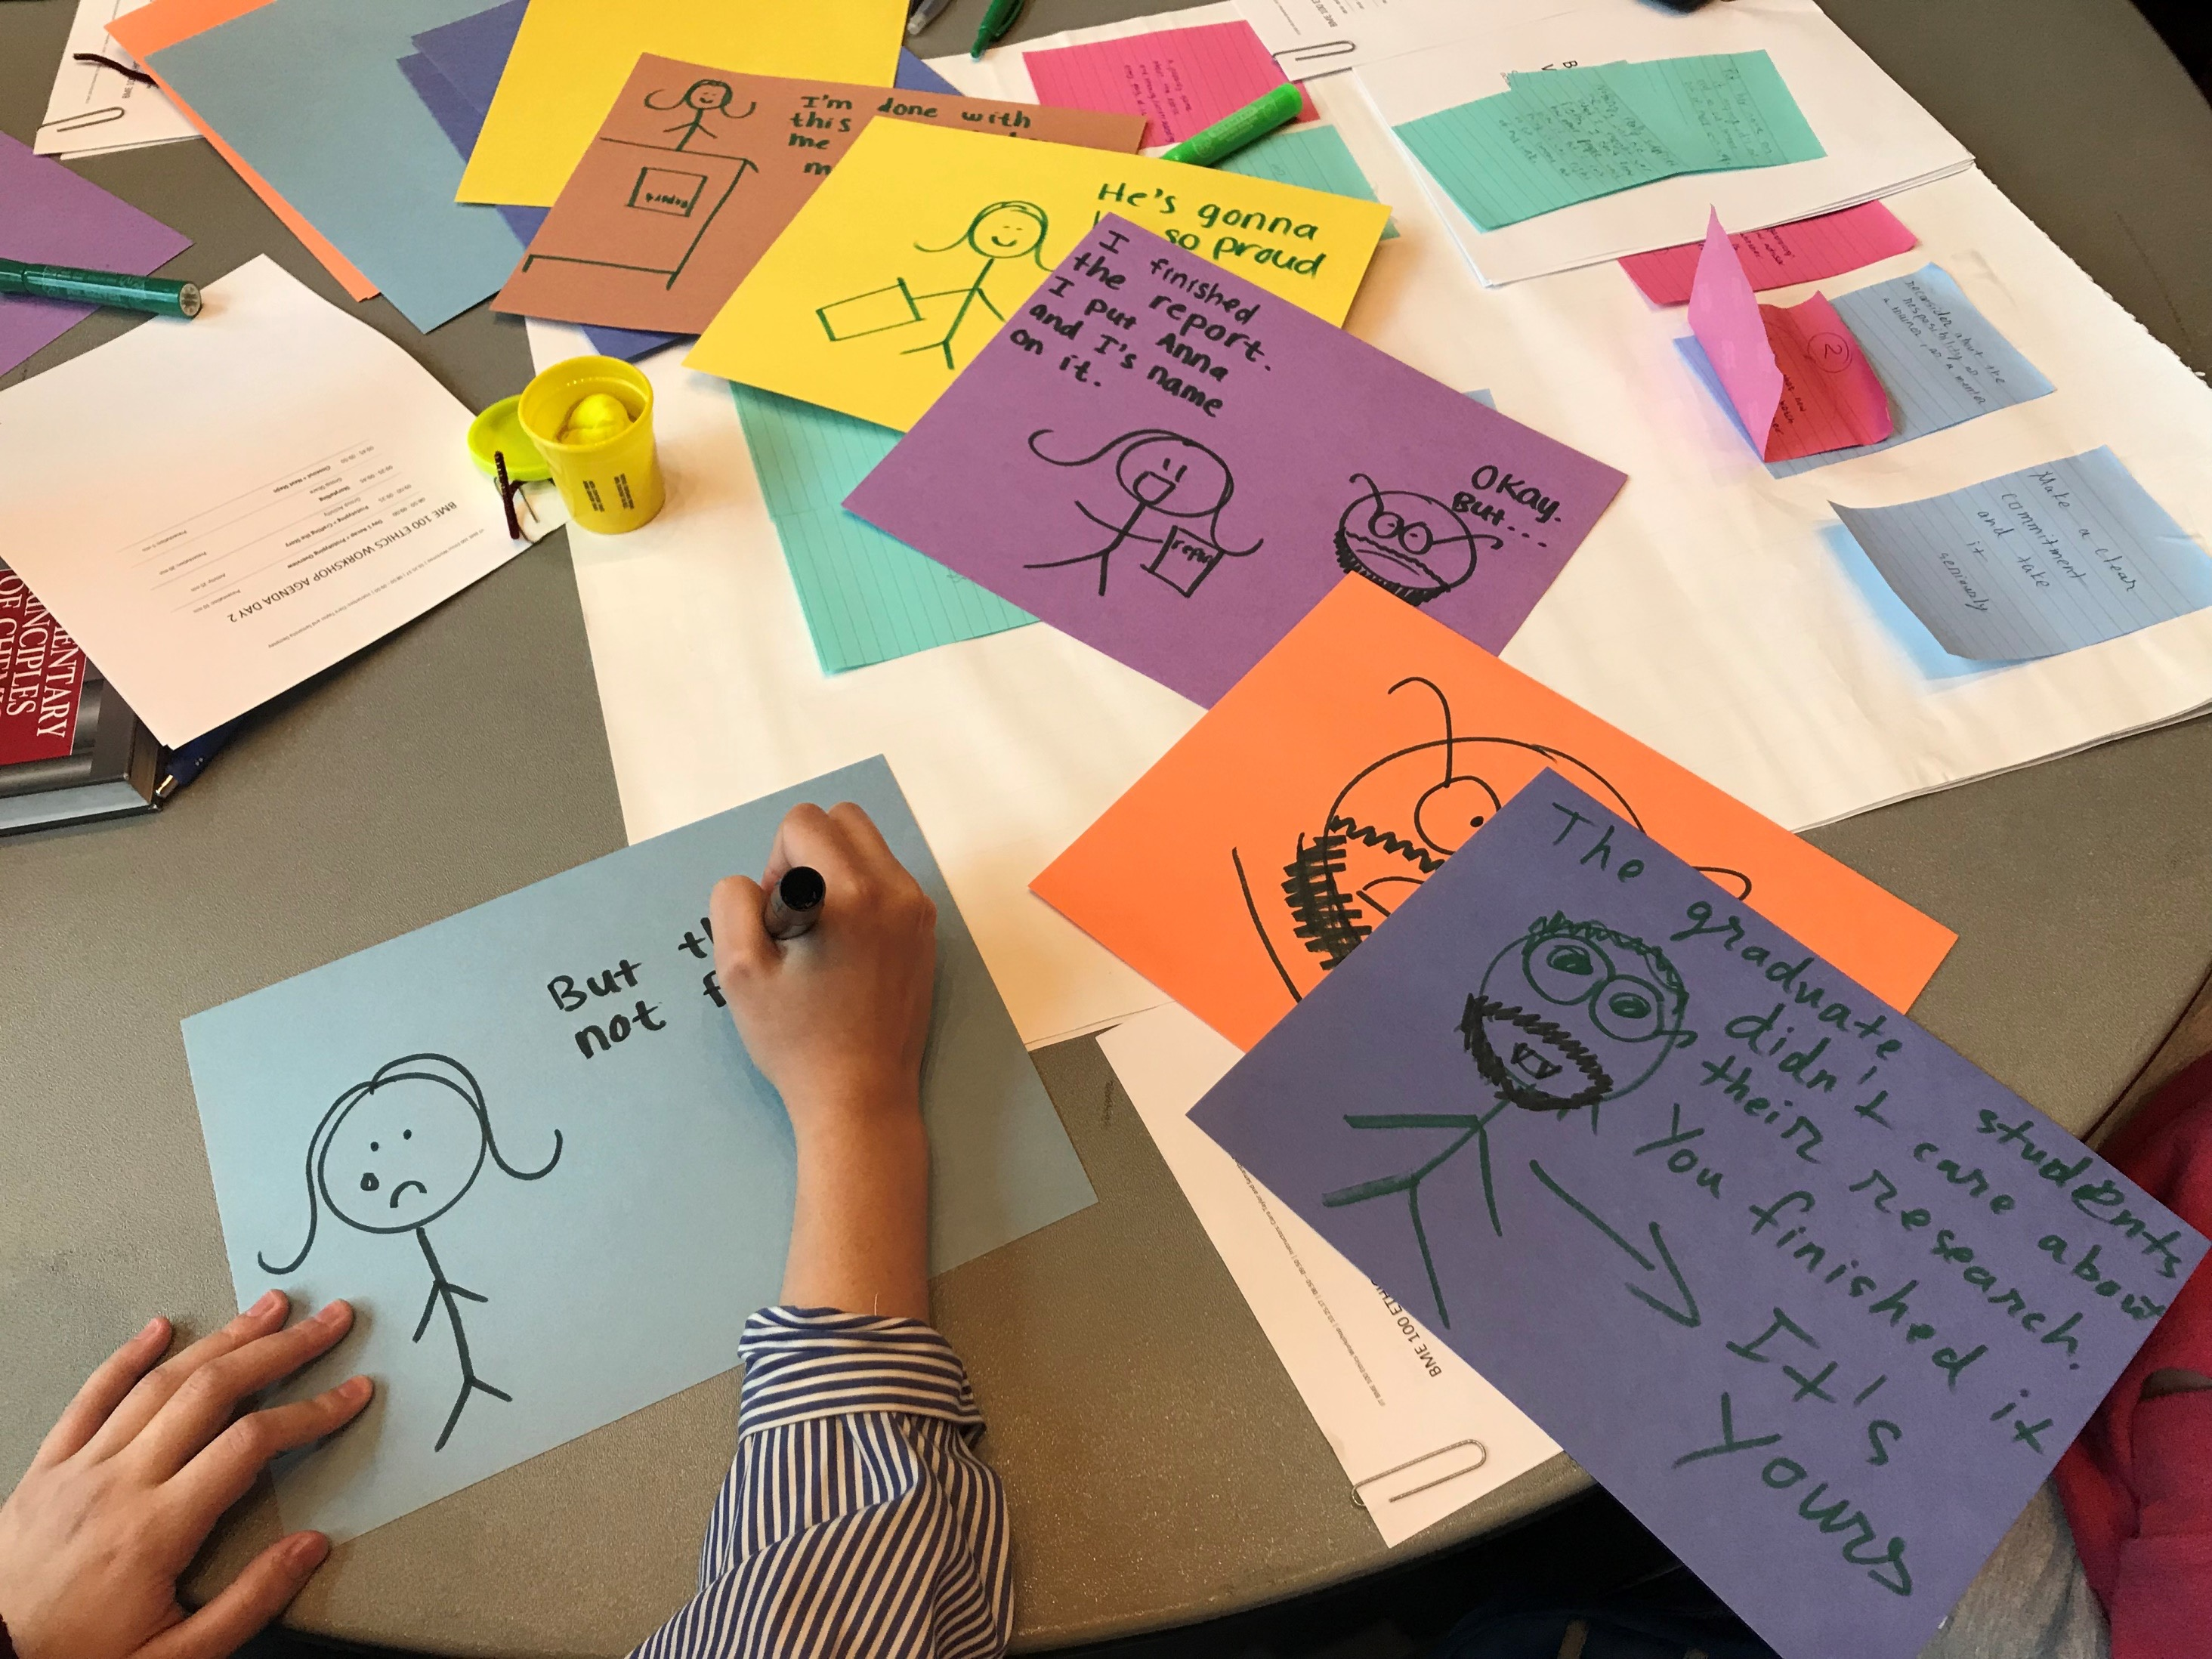
RCR Workshop: Bottom-Up Ethics
Samantha Dempsey + Ciara Taylor + Kelly Laas + Christine Miller
This work is licensed under a Creative Commons Attribution-Non Commercial 4.0 International (https://creativecommons.org/licenses/by-nc/4.0/)

Slide 2
Outline
Introduction to ethics in bioengineering
Ethics terminology
BMES Code of Ethics
Mentoring
Authorship
Case study discussion
Bottom-Up Ethics Workshop
Description
Preparation
Day 1: Embody the problem & Brainstorm
Day 2: Prototype & Storytelling

Slide 3
An Introduction to Ethics in Bioengineering

Slide 4
Intro to ethics.
What is Ethics?
Standards of conduct that everyone in a group (a profession, a workplace, etc.) want everyone else to follow even if it means they have to follow it themselves
What is the difference between Ethics and Law?
Laws are standards of conduct applying
members of a group whether or not they
want it to apply or not
Laws can be ethical OR unethical
In some cases, ethical standards may call on a person to go above and beyond what is required by law
Ladenson, Robert. Ethics in the American Workplace. Horsham, PA: LRP Publications, 1995. Chapter 1 “Some Basic Ethical Concepts”. 1-8.

Slide 5
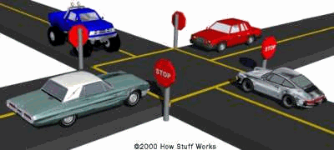
Intro to ethics.
The difference between law and ethics…
It’s two in the morning and you are driving home a friend who lives in a quiet neighborhood. You come across a stop sign at a four-way intersection and see no one around. What do you do, and why?
What do you expect others to do when you drive up to a four-way stop?
What if there were no stop sign? Why?

Slide 6
Intro to ethics.
Science is built on a foundation of trust
Society trusts that research results are accurate and honest.
Researchers trust their colleagues have gathered data carefully, used proper analytic and statistical methods, and have treated work of other researchers with respect.
Science is a cumulative enterprise where new research is built on previous results… if past results are not trustworthy, neither are new scientific discoveries.
National Academy of Sciences, National Academy of Engineering, and Institute of Medicine. 2009. On Being a Scientist: A Guide to Responsible Conduct in Research: Third Edition. Washington, DC: The National Academies Press. https://doi.org/10.17226/12192.

Slide 7
Intro to ethics.
Biomedical Engineering Society Code of Ethics (2004)
"Biomedical engineering is a learned profession that combines expertise and responsibilities in engineering, science, technology, and medicine."
"Since public health and welfare are paramount considerations in each of these areas, biomedical engineers must uphold those principles of ethical conduct embodied in this Code in professional practice, research, patient care, and training."
"This Code reflects voluntary standards of professional and personal practice recommended for biomedical engineers."
For full Code of Ethics of the Biomedical Engineering Society, see https://www.bmes.org/files/CodeEthics04.pdf

Slide 8
Intro to ethics.
Biomedical Engineering Healthcare Obligations
"Biomedical engineers involved in health care activities shall:
Regard responsibility toward and rights of patients, including those of confidentiality and privacy, as their primary concern.
Consider the larger consequences of their work in regard to cost, availability, and delivery of healthcare."
BMES Code of Ethics. (2004). https://www.bmes.org/files/CodeEthics04.pdf

Slide 9
Intro to ethics.
Biomedical Engineering Professional Obligations
"Biomedical engineers in the fulfillment of their professional engineering duties shall:
Use their knowledge, skills, and abilities to enhance the safety, health, and welfare of the public.
Strive by action, example, and influence to increase the competence, prestige, and honor of the biomedical engineering profession."
BMES Code of Ethics. (2004). https://www.bmes.org/files/CodeEthics04.pdf

Slide 10
Intro to ethics.
Biomedical Engineering Research Obligations
"Biomedical engineers involved in research shall:
Comply fully with legal, ethical, institutional, governmental, and other applicable research guidelines, respecting the rights of and exercising the responsibilities to colleagues, human and animal subjects, and the scientific and general public.
Publish and/or present properly credited results of research accurately and clearly."
BMES Code of Ethics. (2004). https://www.bmes.org/files/CodeEthics04.pdf

Slide 11
Intro to ethics.
Biomedical Engineering Training Obligations
"Biomedical engineers entrusted with the responsibilities of training others shall:
Honor the responsibility not only to train biomedical engineering students in proper professional conduct in performing research and publishing results, but also to model such conduct before them.
Keep training methods and content free from inappropriate influence from special interests."
BMES Code of Ethics. (2004). https://www.bmes.org/files/CodeEthics04.pdf

Slide 12
Intro to ethics.
Questions about the BMES Code of Ethics
Have any of you ever read the BMES Code?
What provisions of the code would you expect to see here?
What provisions surprise you, make you wonder why they are included?
Is anything missing from the code?
Why do you think BMES developed this code? How do you think it is used?

Slide 13
Intro to ethics.
Ethics at the convergence of engineering and medicine
Biomedical Engineering is a relatively new field that reframes more well-known bioethical issues, and raises new ones…
What are some issues biomedical engineers face that other engineers don’t?
What are some issues that biomedical engineers face that other professionals in the health care professions don’t?

Slide 14
Intro to ethics.
Why ethics in BME?
"Ethical responsibility...involves more than leading a decent, honest, truthful life. . . . And it involves something much more than making wise choices when such choices suddenly, unexpectedly present themselves. Our moral obligations must . . . include a willingness to engage others in the difficult work of defining the crucial choices that confront technological society . . . ."
Langdon Winner, (1990). “Engineering ethics and political imagination.” Pp. 53-64 in Broad and Narrow Interpretations of Philosophy of Technology: Philosophy and Technology 7, edited by P. Durbin. Boston: Kluwer.

Slide 15
Intro to ethics.
Responsible Conduct of Research
Authorship and publication
Data management practices
Conflicts of interest
Collaborative research
Student/advisor relations & mentoring
Peer review
Research involving humans/human tissues/animals
Research misconduct
Scientist as a responsible member of society
How do you learn about these issues?
Online tutorials (CITI, Office of Research Integrity)
Workshops
Ask questions
Find mentors
Start discussions
National Institutes of Health. “Update on the Requirement for Instruction in the Responsible Conduct of Research. November 24, (2009). http://grants.nih.gov/guide/notice-files/not-od-10-019.html

Slide 16
Intro to ethics.
Scientific Misconduct
Fabrication – making up data or results
Falsification – manipulating research materials, equipment, or processes, or omitting data or results such that the research is not accurately represented in the research record.
Plagiarism- the appropriation of another person’s ideas, processes, results, or words without giving appropriate credit.
Of 3,247 scientists surveyed in a 2005 study of NIH-funded scientists, only 2% reported seeing others committing misconduct or engaging in misconduct themselves…
However, over 33% of scientists self-reported engaging in questionable research practices such as overlooking others’ use of flawed data or questionable interpretation of data.
National Science Foundation Policy on Research Misconduct 45 CFR 689. http://www.nsf.gov/oig/misconscieng.jsp
Survey from Martinson, Brian, et al. “Scientists Behaving Badly” Nature 435: 737-738 (9 June 2005)

Slide 17
Intro to ethics.
Standards of Conduct in Science Do Exist…
Professional Codes of Conduct
Funding Agencies (NSF, NIH, DOE) guidelines
Laws & Regulations protecting human/animal participants
Guidelines of scientific journals
Guidelines & standards of discipline
Guidelines & standards of your lab (written & unwritten)
If you can’t find answers, ask questions!

Slide 18
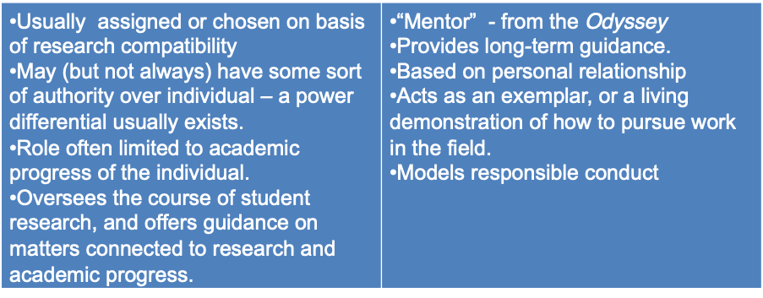
Intro to ethics.
Advisor
Mentor
Weil, Vivian. (2001)." Mentoring: Some Ethical Considerations." Science and Engineering Ethics. 7 (4): 471-482.

Slide 19
Intro to ethics.
Advisor Responsibilities
Provides sound academic advice.
Commitment to the education and training of student, provide opportunities to develop skills related to profession
Professional /collegial interaction with students
Encourages creative and independent student learning
Provides impartial evaluation of student’s work
"The adviser is the primary gatekeeper for the professional self-esteem of the student, the rate of progress toward the degree, and access to future opportunities.“
–S. E. Widnall, past president of AAAS
University of Michigan, Ann Arbor. (2009). Rackham Graduate School. How to Mentor Graduate Students: A Guide for Faculty.

Slide 20
Intro to ethics.
Student Responsibilities
Dedicate appropriate time and energy to accomplishing academic excellence and completion of the program.
Understand time constraints on faculty advisors
Professional/collegial interaction with others
Regular communication with advisor and other members of lab.
University of Michigan, Ann Arbor. (2009). Rackham Graduate School. How to Get the Mentoring You Want: A Guide for Graduate Students at a Diverse University.

Slide 21
Intro to ethics.
Authorship
Substantial contributions to the conception or design of the work; or the acquisition, analysis, or interpretation of data for the work; AND
Drafting the work or revising it critically for important intellectual content; AND
Final approval of the version to be published; AND
Agreement to be accountable for all aspects of the work in ensuring that questions related to the accuracy or integrity of any part of the work are appropriately investigated and resolved.
Authors should meet conditions 1, 2, 3 and 4.
International Committee of Biomedical Journal Editors. “Defining the Role of Authors and Contributors.” http://www.icmje.org/recommendations/browse/roles-and-responsibilities/defining-the-role-of-authors-and-contributors.html

Slide 22
Intro to ethics.
Responsibilities of authors
Be prepared to take responsibility for its content in case the work contains errors or deceptions.
Be able to certify that the paper is accurate, and that that it discloses relevant information such as data, methodology, and limits of the study.
Disclose sources of funding as well as any financial interests that could generate a conflict of interest.
Ensure all other authors approve the final version of the manuscript.
Avoid duplicate and/or redundant publications.
Practices to avoid also include self-plagiarism/text recycling, selective reporting of results, and ghost authorship (including authors who did not contribute to the paper because they are famous, add prestige).

Slide 23
Intro to ethics.
Keys to resolving authorship controversies
Guidelines often change from discipline to discipline, lab to lab.
The order authors are listed on a paper is important, being first author can be key in a “publish or perish” world.
An important rule of thumb is to talk about these issues before you start the writing process, don’t assume you will be an author.
There are many tools available to help authors discuss these issues. One is “Preempting Discord: Prenuptial Arrangements for Scientists,” available at http://ori.hhs.gov/preempting-discord-prenuptial-agreements-scientists

Slide 24
Intro to ethics.
Case Study: The Graduate Student Laborer
"Joe McGrath is a graduate student who has been working extremely hard and has a job lined up at a pharmaceutical company for after he graduates. He also holds a position in Dr. Smith’s research lab. Dr. Smith, has asked Joe to work over the weekend to help him get ready for a presentation that is due on Monday, and even though Joe has his own experiments to do, he agrees.
In a later discussion, Joe finds out that he will be listed as fourth author on the presentation and that Dr. Smith will not be coming in to the lab over the weekend. Joe is left to consider if he should make the figures for the presentation as his advisor asked, or if he should work on his own experiments as he originally planned."
"The Graduate Student Laborer.” from Graduate Research Ethics: Cases and Commentaries - Volume 6, (2002). https://www.onlineethics.org/Resources/gradres/gradresv6/laborer.aspx

Slide 25
Intro to ethics.
Case study discussion
Is it appropriate for Smith to ask Joe to work on Saturday? Is it appropriate in light of the fact that Smith is not going to work? Are there valid reasons why Smith might ask Joe to work although he is not planning on working himself?
Would it seem less onerous a request to complete the figures and graphs at the sacrifice of his dissertation work if Joe were compiling and analyzing data from his own experiments rather than data from students who left the program?
What are the proper roles and responsibilities of graduate students in preparing presentations that include the entire research group's efforts?
What are appropriate criteria for authorship?
Is data collection always more significant than data compilation and analysis?
Should Joe ask to be placed higher on the list of authors? How should he approach Smith about his concerns
"The Graduate Student Laborer.” from Graduate Research Ethics: Cases and Commentaries - Volume 6, (2002). https://www.onlineethics.org/Resources/gradres/gradresv6/laborer.aspx

Slide 26
Bottom-Up Ethics: Real World Training
for Professional Practice

Slide 27
Bottom-up ethics. Description.
Workshop Description
This workshop seeks to identify factors relevant to ethical research and to promote the cultivation of an ethical culture in experimental laboratories by integrating research stakeholders in a bottom-up approach in developing context-specific codes of ethics-based guidelines or a game or other prompt to increase discussion around these ethical questions.
Quote from professor…
"I felt the workshop was an interactive way of teaching ethics to freshmen. This is very important for biomedical engineering students.” - Prof. Promila Dhar, BME Faculty Instructor, Illinois Institute of Technology

Slide 28
Bottom-up ethics. Workshop prep.
Instructions for workshop prep
Pick topics relevant to the ethical issues students are facing within their discipline. (For the BME 100 workshop we chose Authorship and Collaboration, Mentorship, Contracts, and General Codes)
Print participant packets for each student
Divide groups into no more than 6 per table
Each group should have a table topic
Get ready to have fun!
Note: The activities outlined in this workshop were originally conducted over the course of two days, but if time permits could be done in one day.

Slide 29
Bottom-up ethics. Activities day 1.
Activity: Embodying the Problem Individually
Read the scenario in your participant packet and consider how you would tackle and overcome the ethical problem presented to you. (10 minutes)
Reflect on what surprised you while thinking through your individual scenario? How did what you learn relate to how you think about your own personal ethics? What did you learn about yourself or the education system through this exercise? (5 minutes)

Slide 30
Bottom-up ethics. Activities day 1.
Activity: Embodying the Problem in Teams of Two
Pick a partner from your group. Each of you will take on a different role for the next scenario. Read your scenario and discuss how you would tackle and overcome the ethical problem from the perspective of your new role. (10 minutes)
Regroup with the rest of your group members and discuss how you approached your scenario from the perspective of your new role. (5 minutes)

Slide 31
Bottom-up ethics. Activities day 1.
Activity: Brainstorm Individually
It’s time to think about the future of ethics for students!
Your goal is to come up with an ethical experience/solution for future students – this could be a code, toolkit, guidebook or something else to create awareness and encourage communication. (5 minutes)

Slide 32
Bottom-up ethics. Activities day 1.
Activity: Brainstorm As a Group
Share all the ideas you brainstormed within your group. Add all the post-it notes to a large easel pad. Each group member votes on 3 of their favorite ideas.
The idea with the most votes will be the idea your group prototypes on Day 2!

Slide 33
Bottom-up ethics. Activities day 2.
Activity: Prototype
In your group, expand the idea your group voted on at the end of brainstorming.
(15 minutes)
Think about the following…
What is the problem this is solving?
Who is this for?
How would you describe it?
How do students, mentors, and/or other people involved come to know about it?
How long is it used for?
What are the outcomes of it being used?
Who benefits from it? Who may be harmed by it?

Slide 34
Bottom-up ethics. Activities day 2.
Activity: Craft your story
Craft a 2-3 minute story to communicate your idea and prototype to the entire class. This can be done by creating a poster, story board, sculpture, performance, etc.
(10 minutes)
Your story should include:
The topic or problem your group is addressing
The name of your ethical experience
The people who will use it
The way it works
The outcomes of its use

Slide 35
Bottom-up ethics. Activities day 2.
Activity: Storytelling
Each group will share the story of their ethical experience with the class!
(20 minutes)

Slide 36
Examples from BME 100

Slide 37
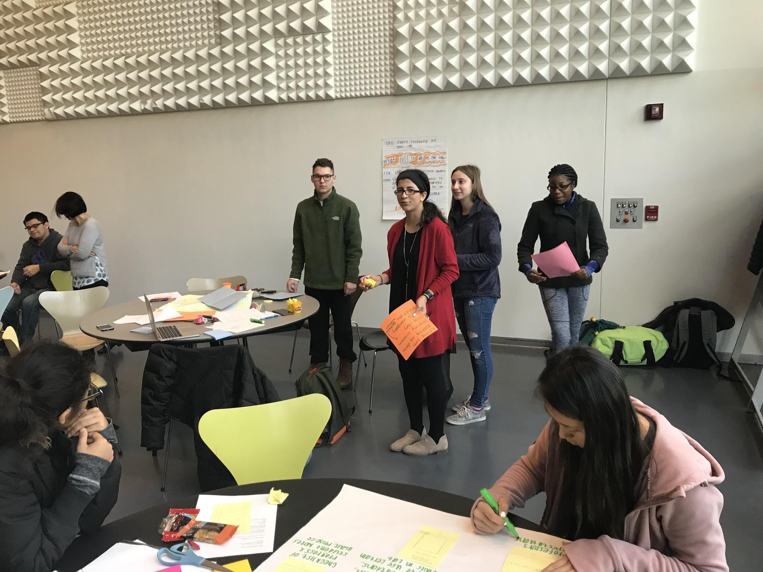
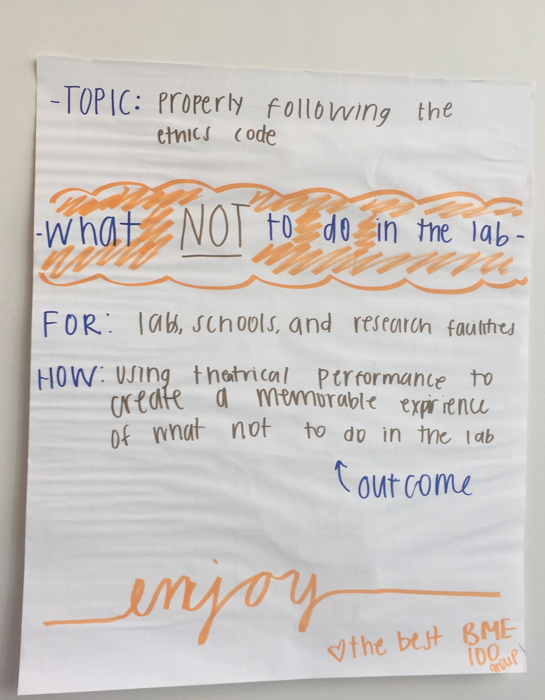
Bottom-up ethics. Examples from BME 100.
Skit: What not to do in the lab
Notes:
Examples of BME projects

Slide 38
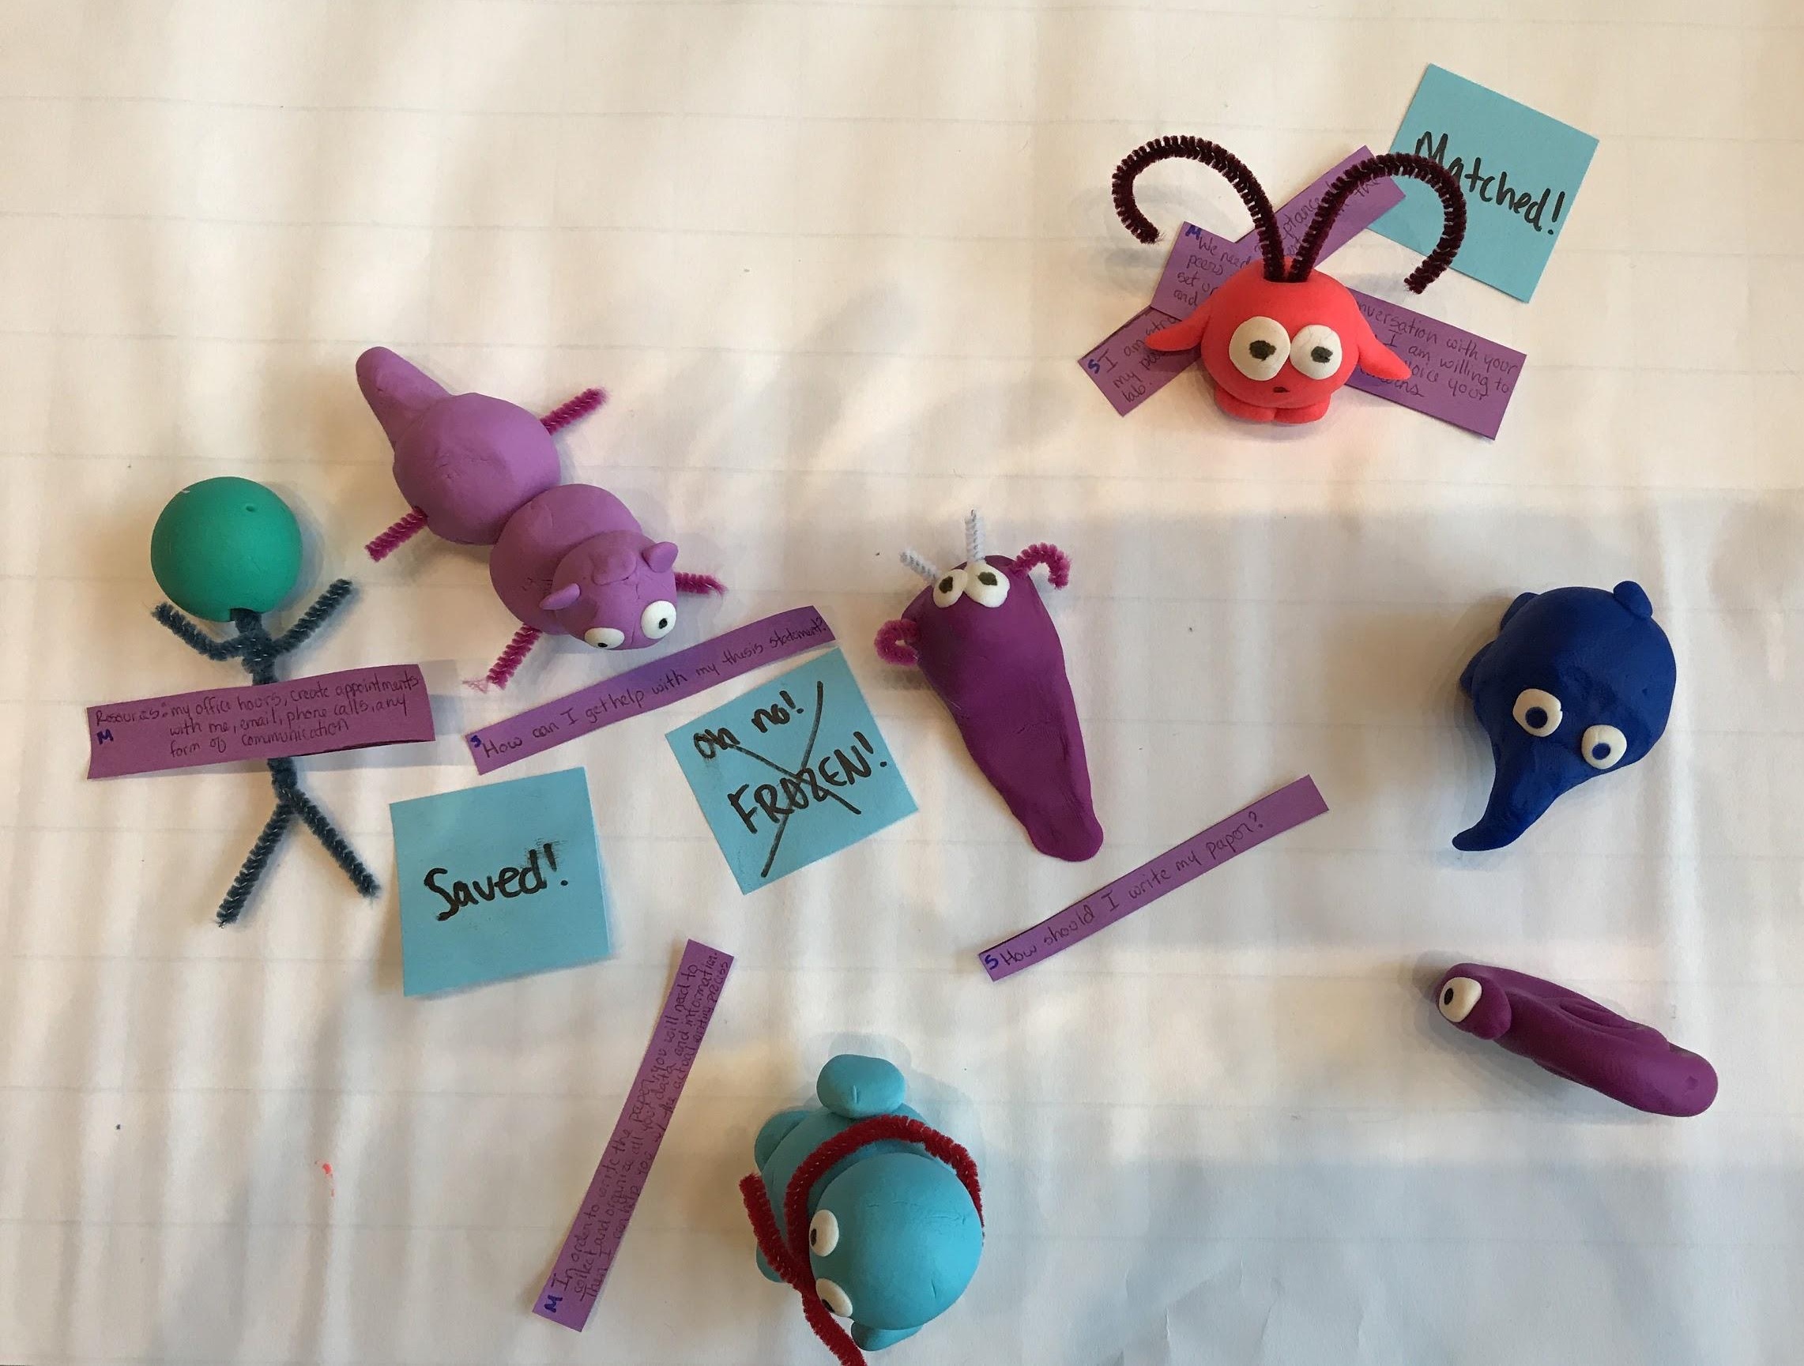
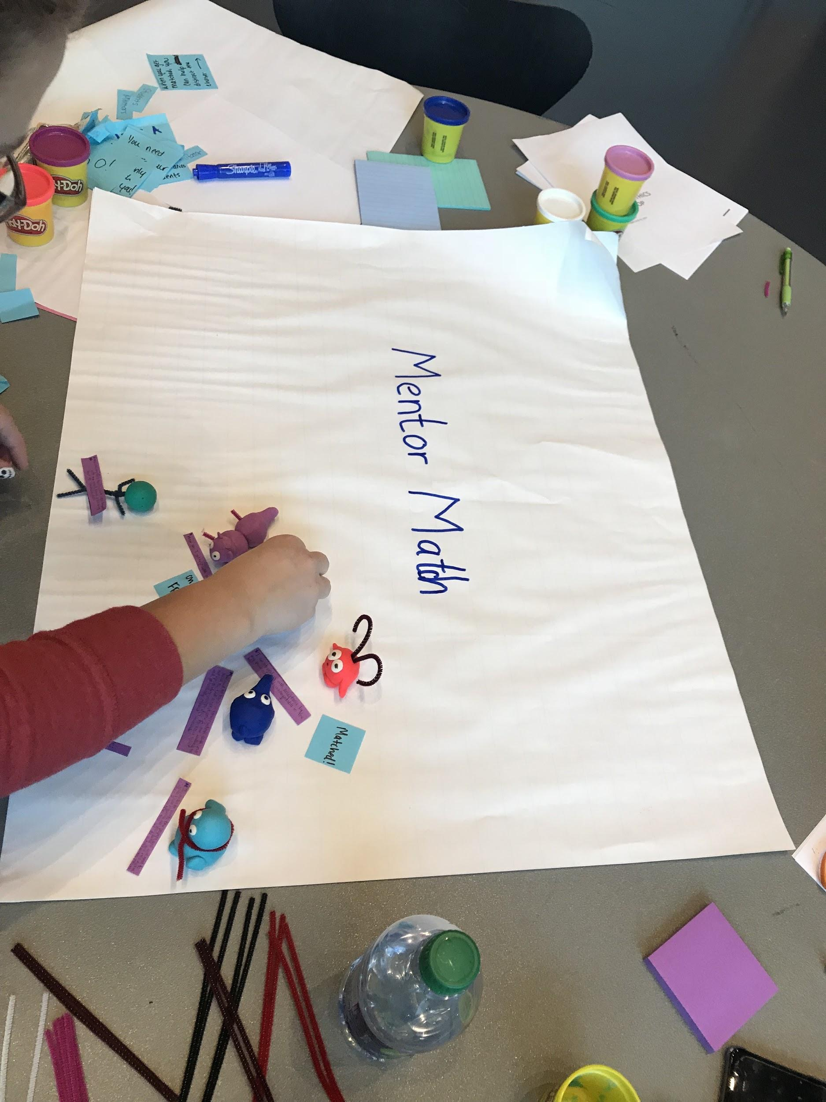
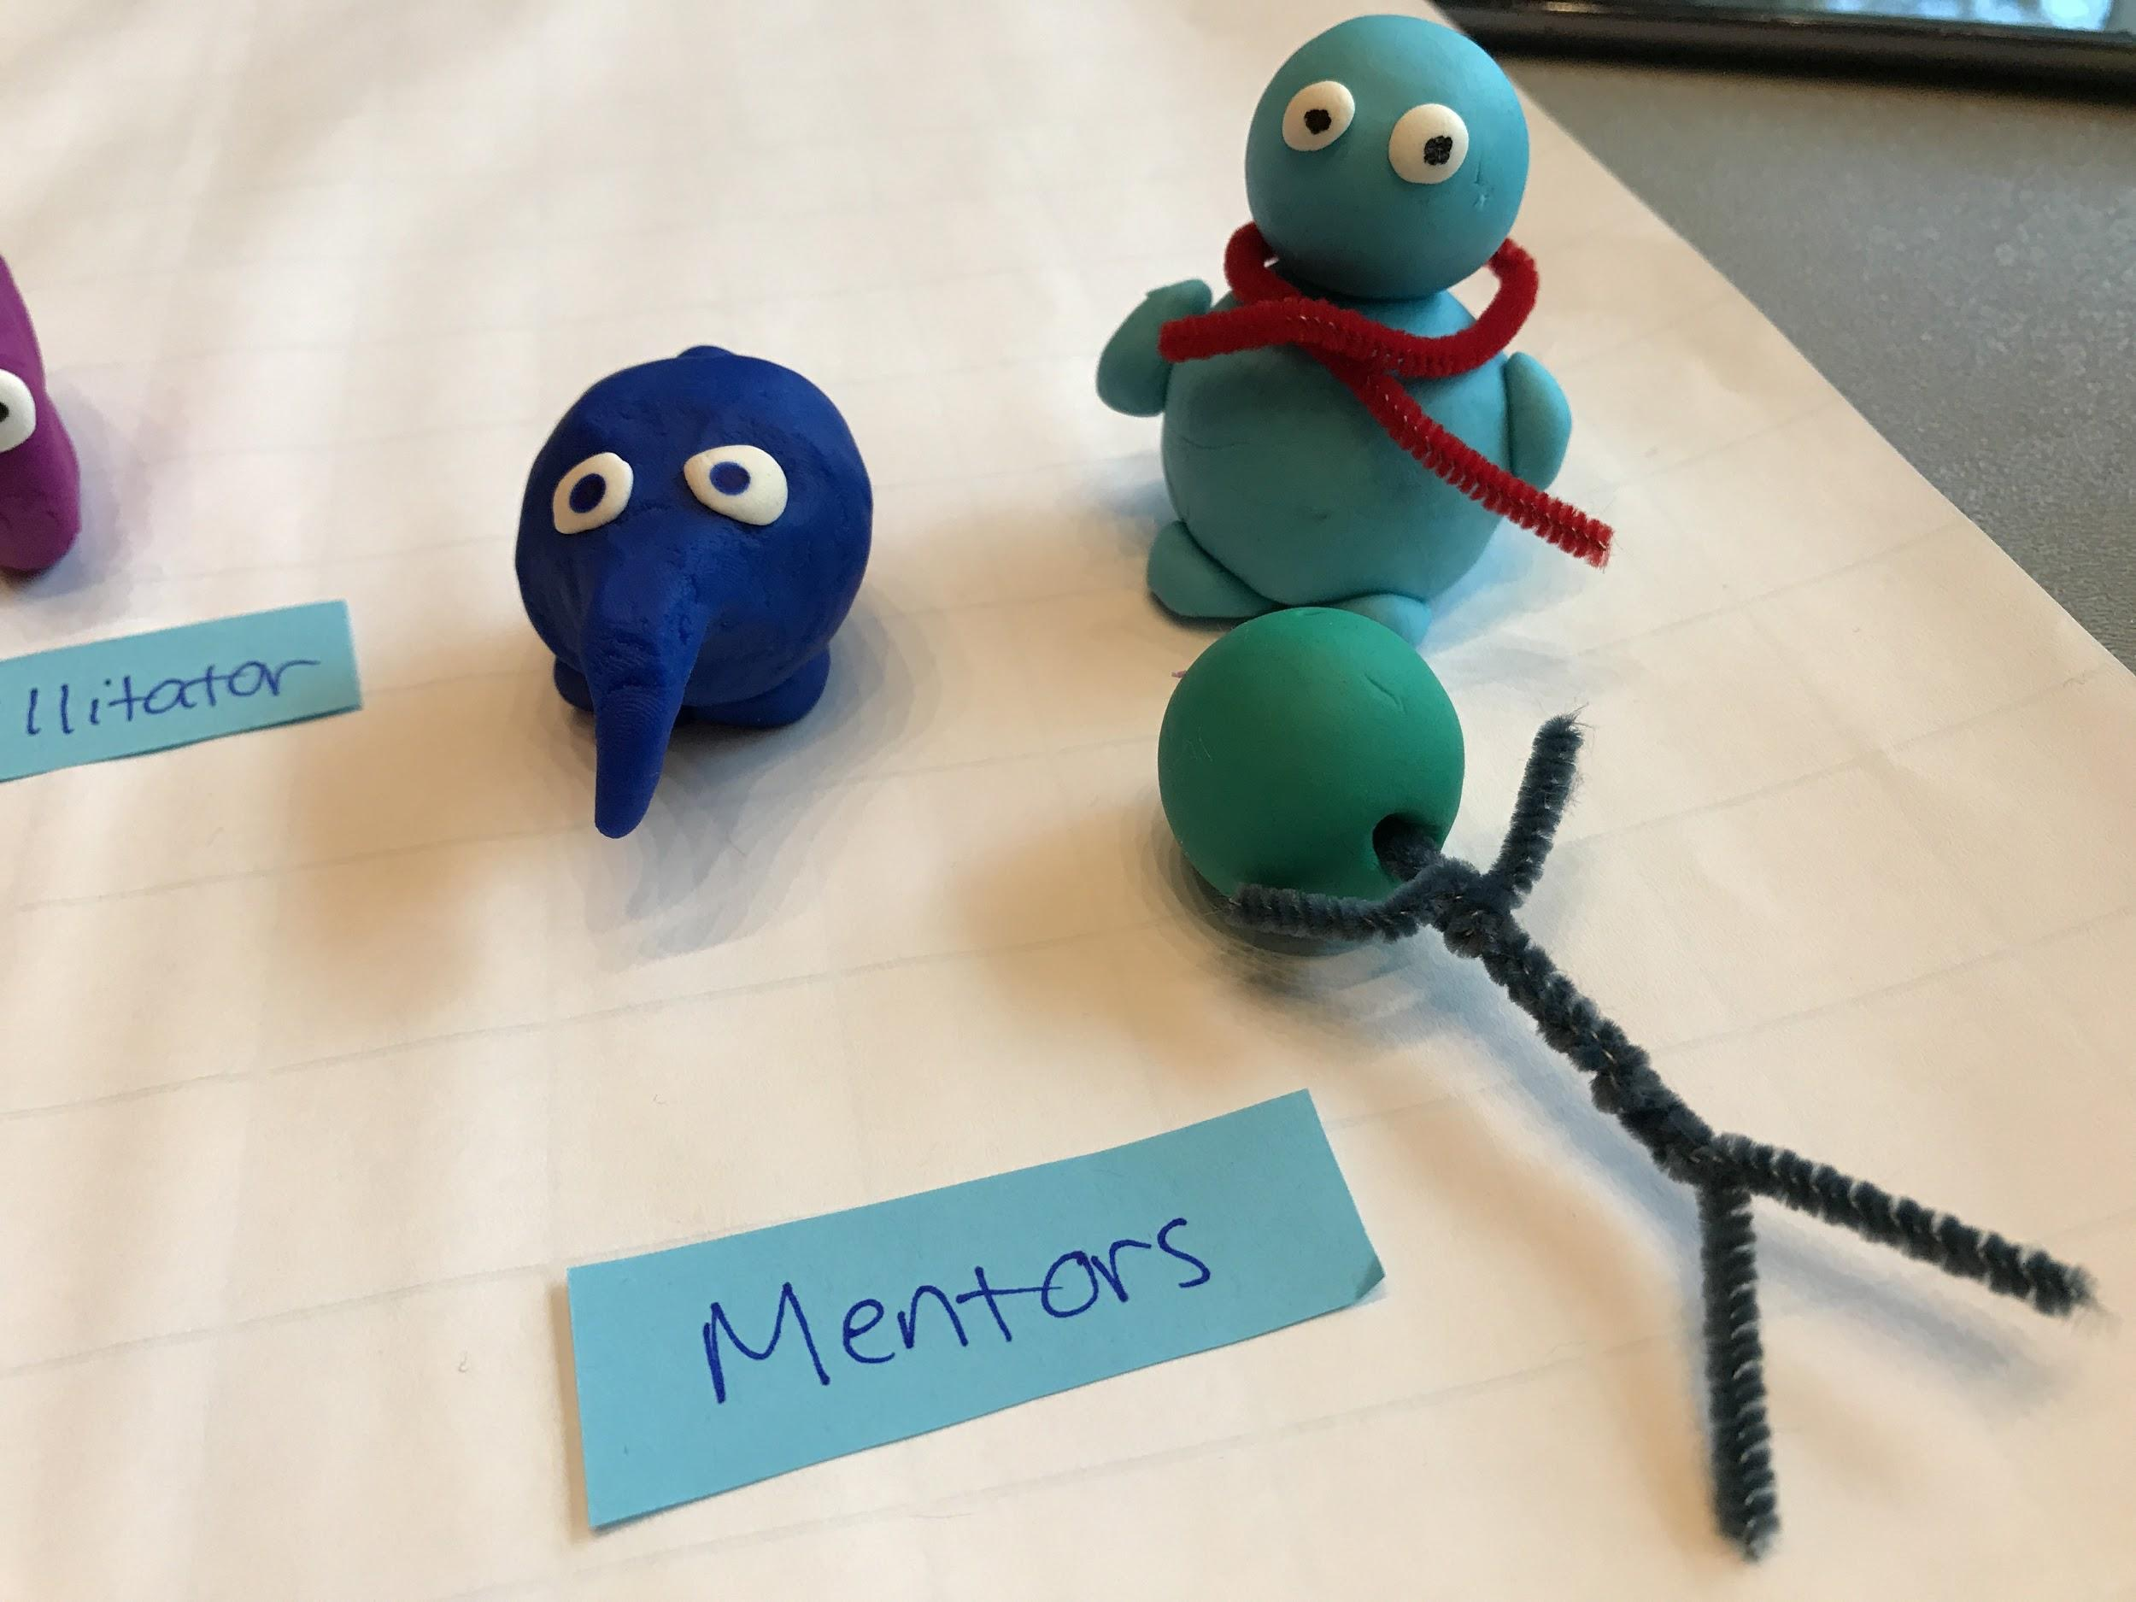
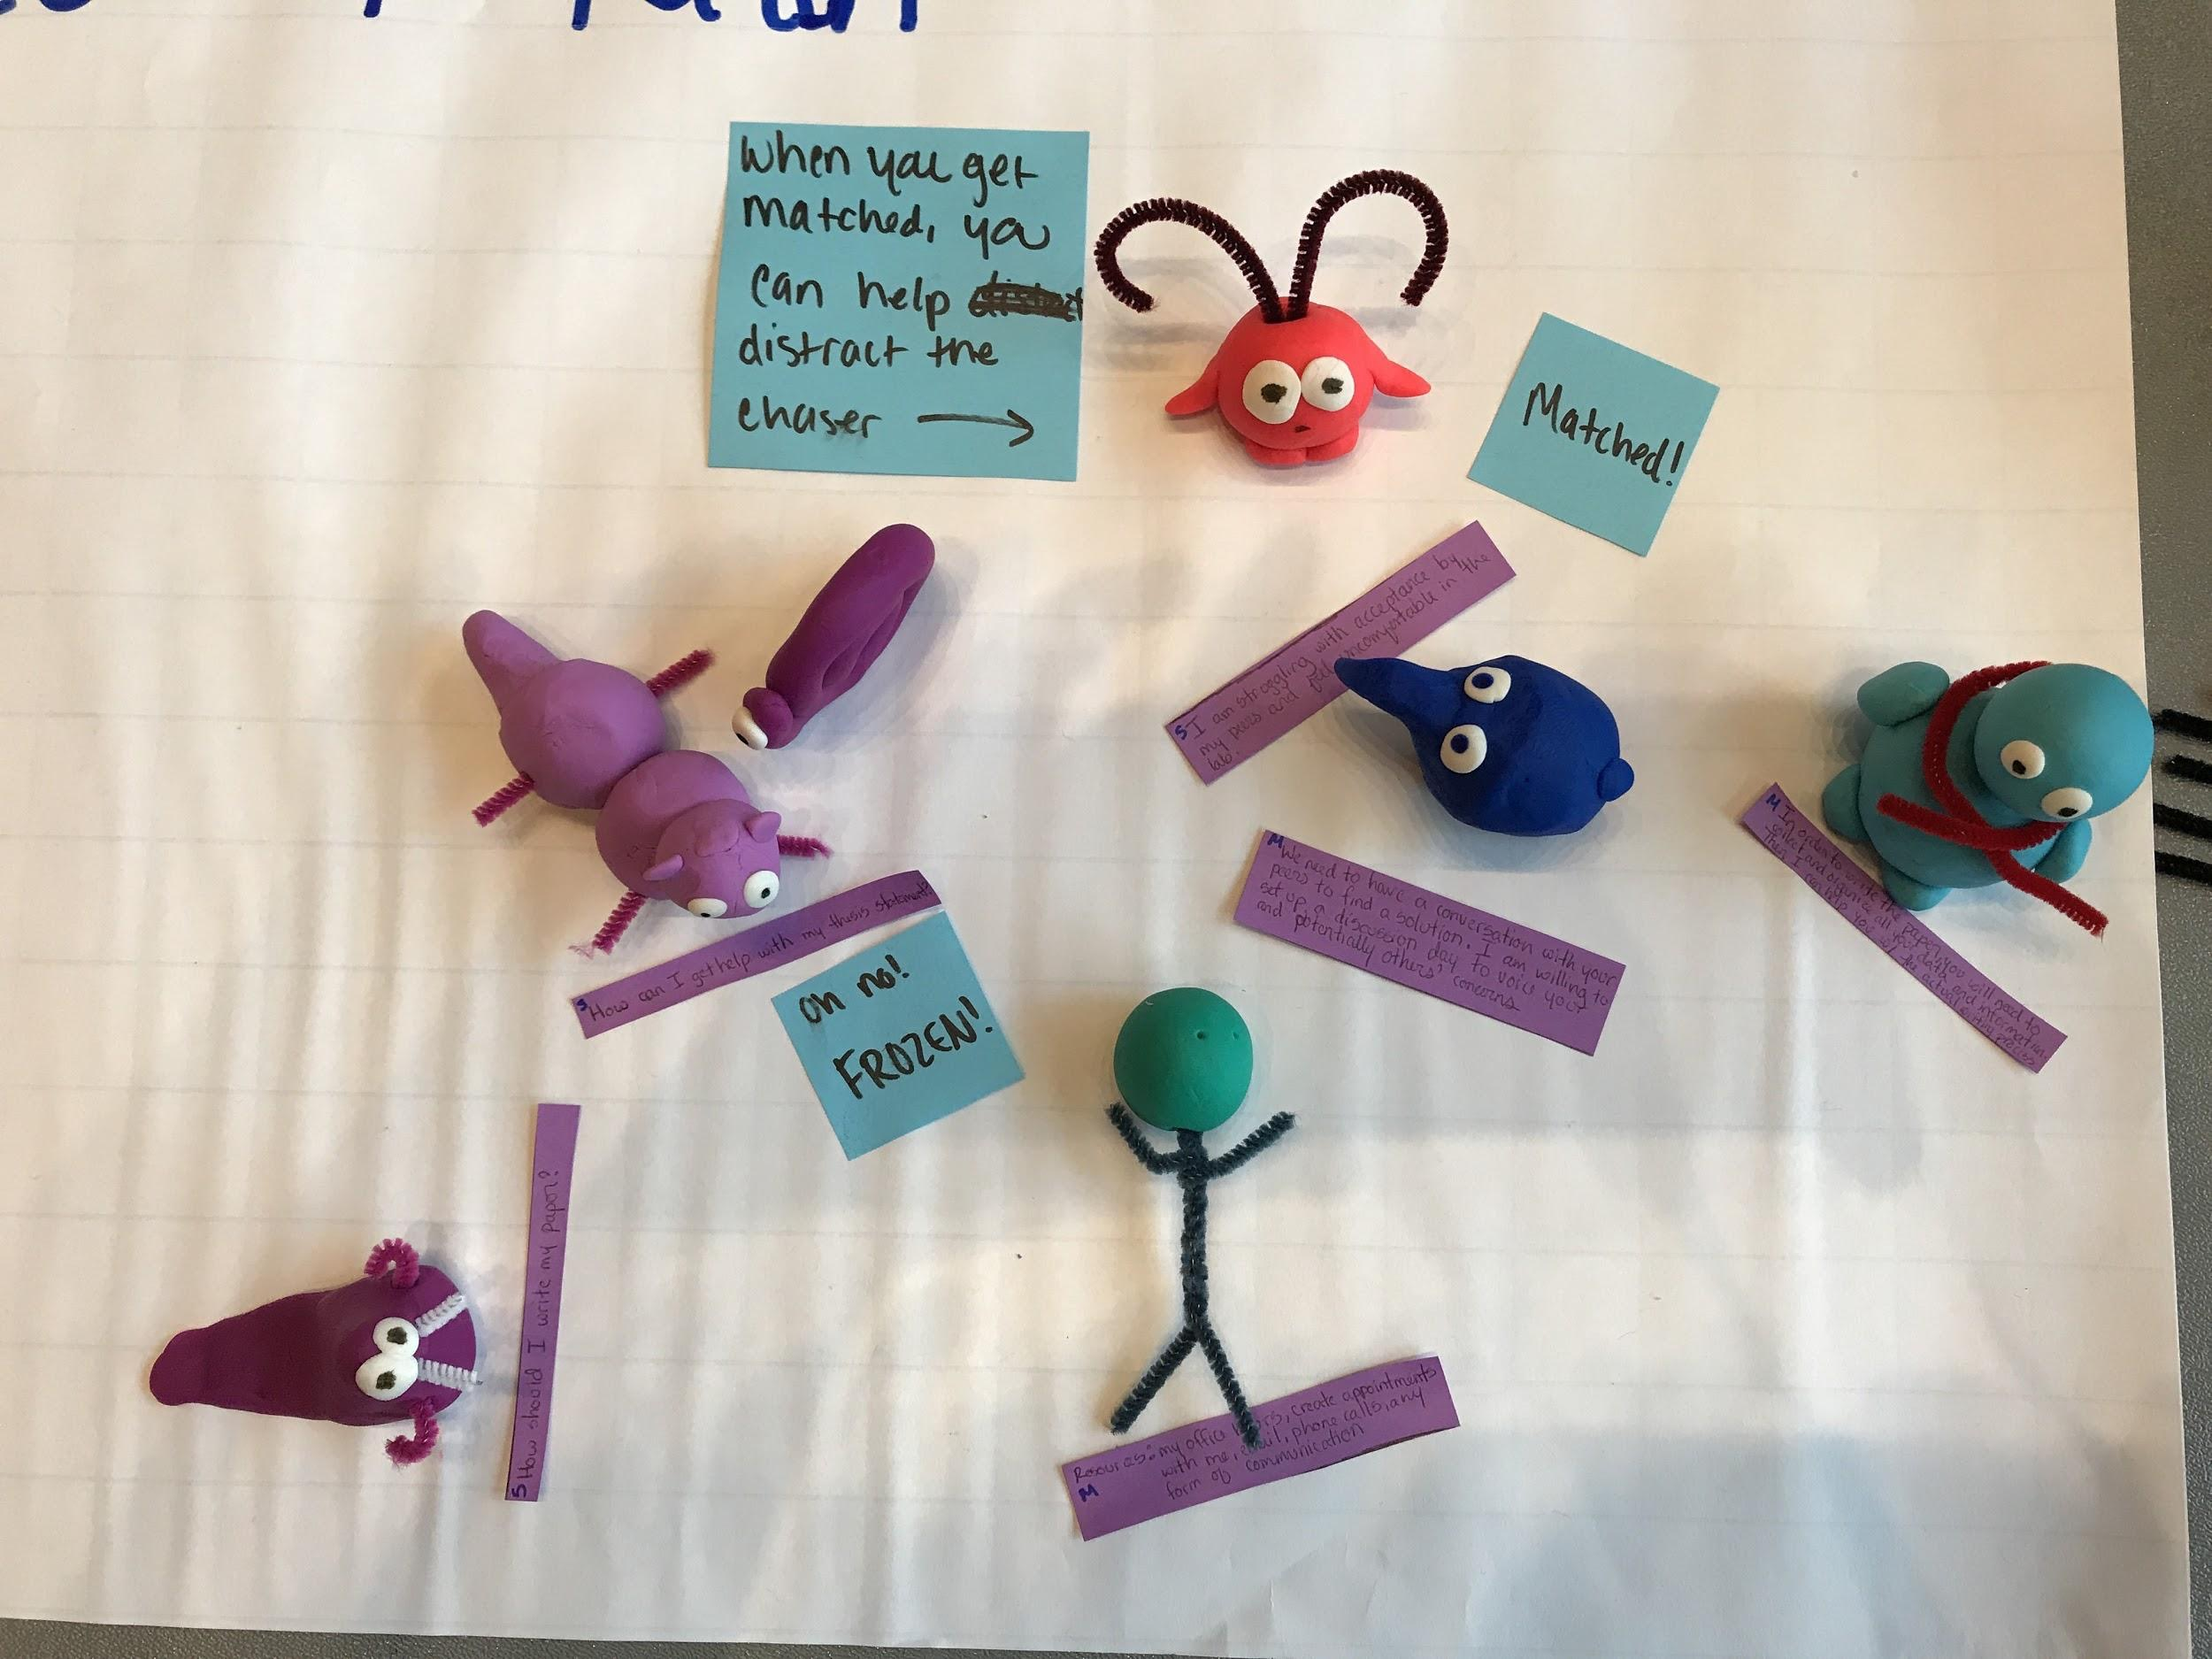
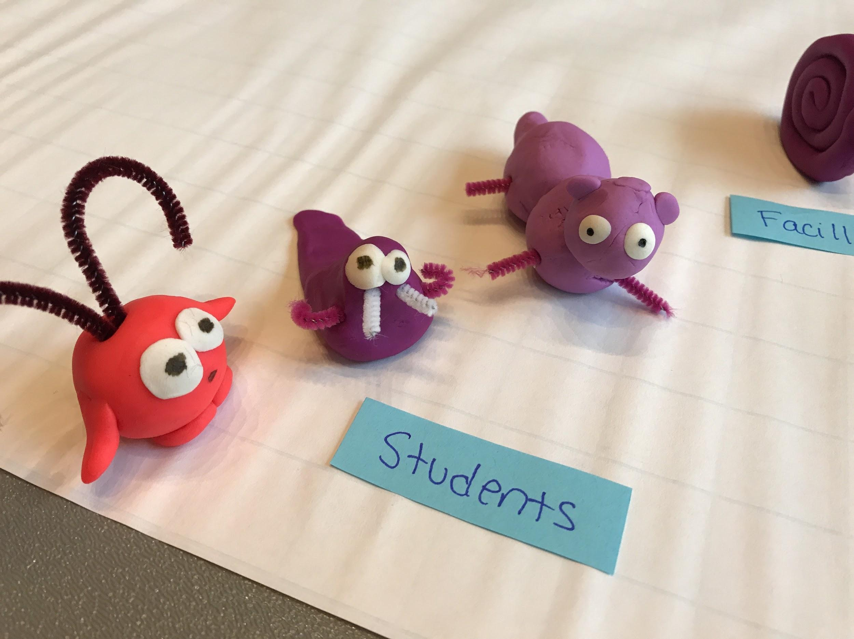
Bottom-up ethics. Examples from BME 100.
Game: Mentor Match
Notes:
Examples of BME projects

Slide 39
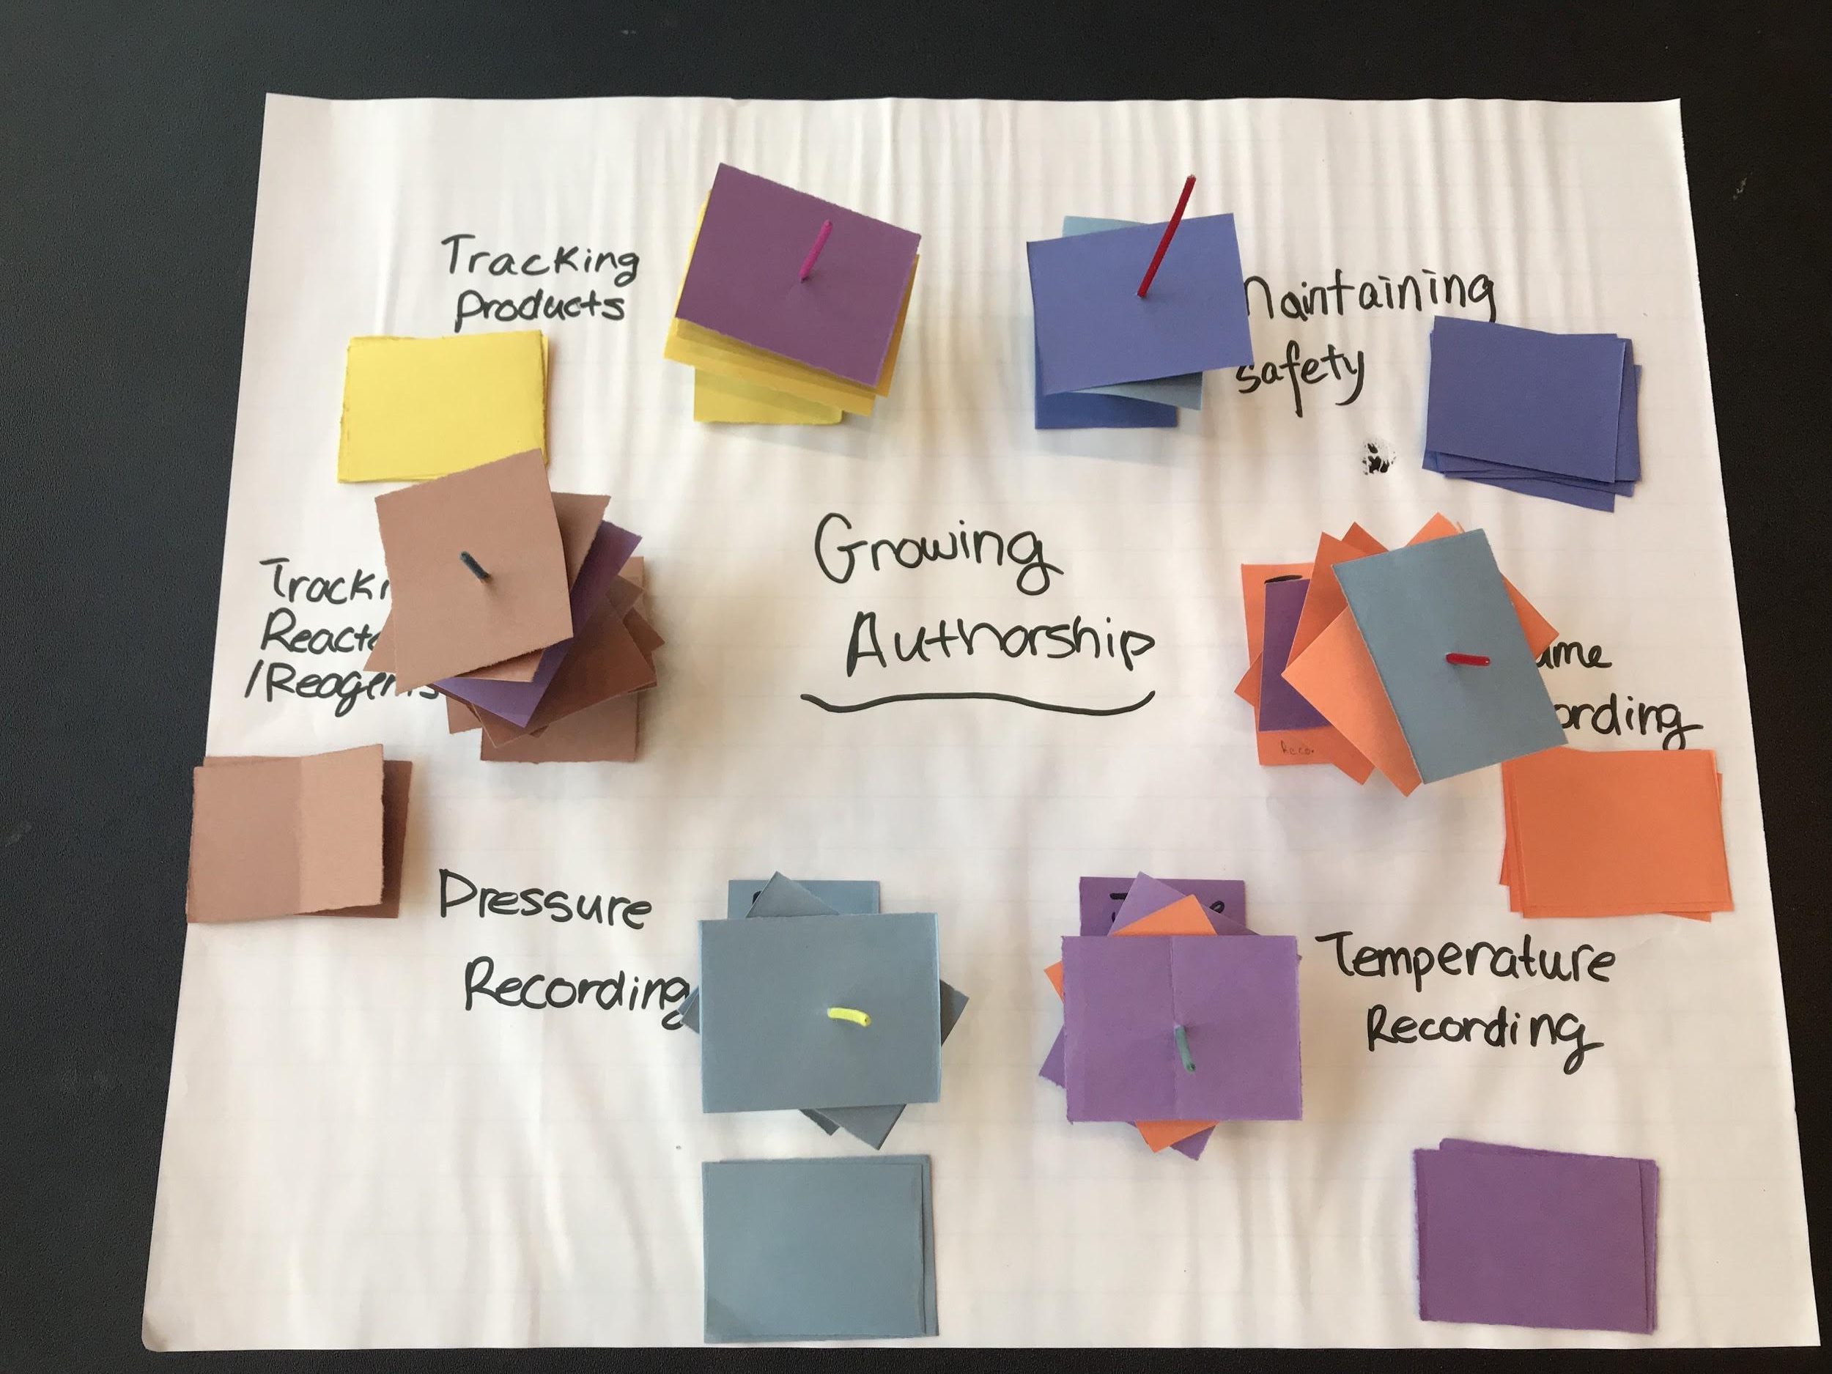
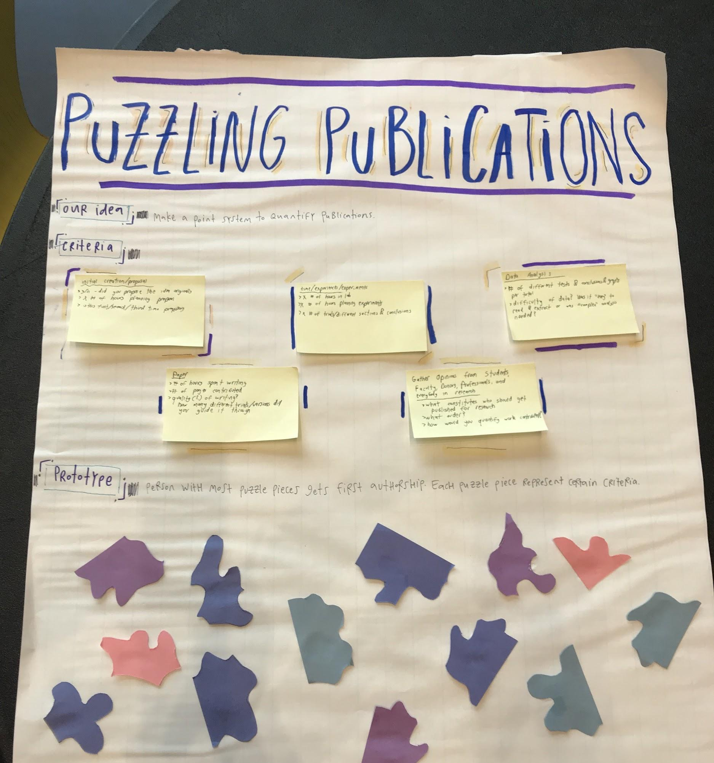
Bottom-up ethics. Examples from BME 100.
Interactive puzzle like approaches to authorship
Notes:
Examples of BME projects

Slide 40
Thank you!

