Slide 1
Peer Teaching Workshop
Perhaps one of a number of sessions
Integrated into a schedule of meetings
Similar in frequency to a journal club, but not sharing science/data - instead sharing ideas about teaching
In this case, integration of ethics in STEM

Slide 2
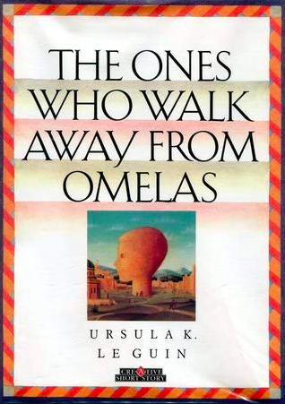
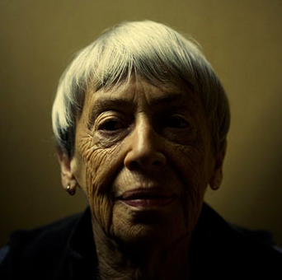
Audience: We envision a faculty group who is already using case studies, but not pushing through to the importance of moral imagination. Offer the using a fantasy/mythological tale to identify the moral imagination opportunities with other STEM cases
https://www.dystopic.co.uk/

Slide 3
Objective:
Imagine different ways to incorporate learning modules, for the purpose of provoking Imaginal Capacity in teaching of Ethics in their field

Slide 4
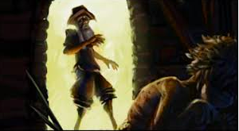
Discuss the conditions of the story, context of the story (catch up all participants)
Gather input from multiple participants (Hearing the Subject, Think Aloud, K-W-L)
This would allow for “catching up” for those who haven’t read - and gather multiple impressions of the text
https://atadpweeblycom.weebly.com/the-ones-who-walk-away-from-omelas-reflection.html

Slide 5
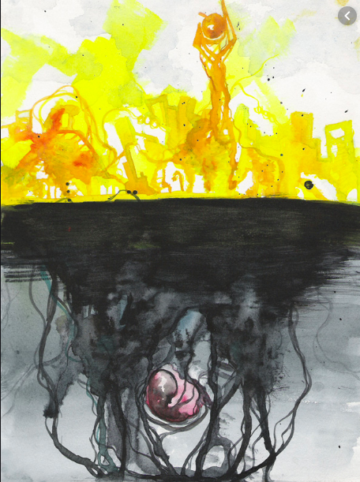
Empathy/Self-reflection: How would you imagine yourself
As the child?
As a parent of the child?
As a person living in the city (and decides to stay)
As a person leaving the city?
https://www.deviantart.com/hliwwa/art/Omelas-Concept-art-134303519

Slide 6
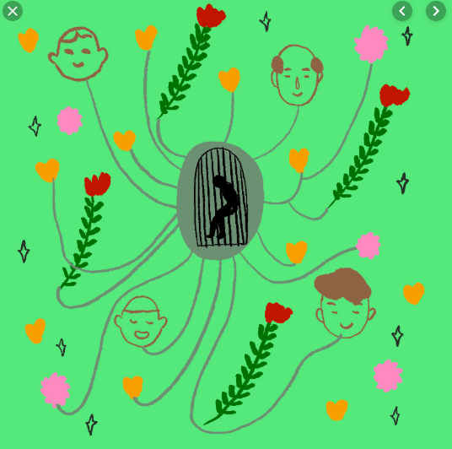
What values are foundational to each of the last two groups?
What are their decisions based upon?
https://www.behance.net/galleries/illustration

Slide 7
How is Moral Imagination demonstrated here?
Contrast to Sympathy? Empathy?
Factual analysis?

Slide 8
How could this relate to your own discipline/familiar encounters?

Slide 9
In our world, this would be only the beginning of the conversation about creative, alternative ways to increase the attention to and growth in the area of ethics in STEM education.
Thank you!
http://www.authorstream.com/Presentation/tccampa-182107-ones-walk-away-omelas-leguin-fiction-story-utopia-education-ppt-powerpoint/

Slide 10
For more information on the development of Moral Imagination:
Jalali, Y., & Matheis, C. (2017, June), Liberation in Education: What Role Do Liberatory Praxis and Theory Play in Fostering Critical Thinking? Paper presented at 2017 ASEE Annual Conference & Exposition, Columbus, Ohio. https://peer.asee.org/28629

